Slide 1

Sets in Code
Computational Core

Slide 2
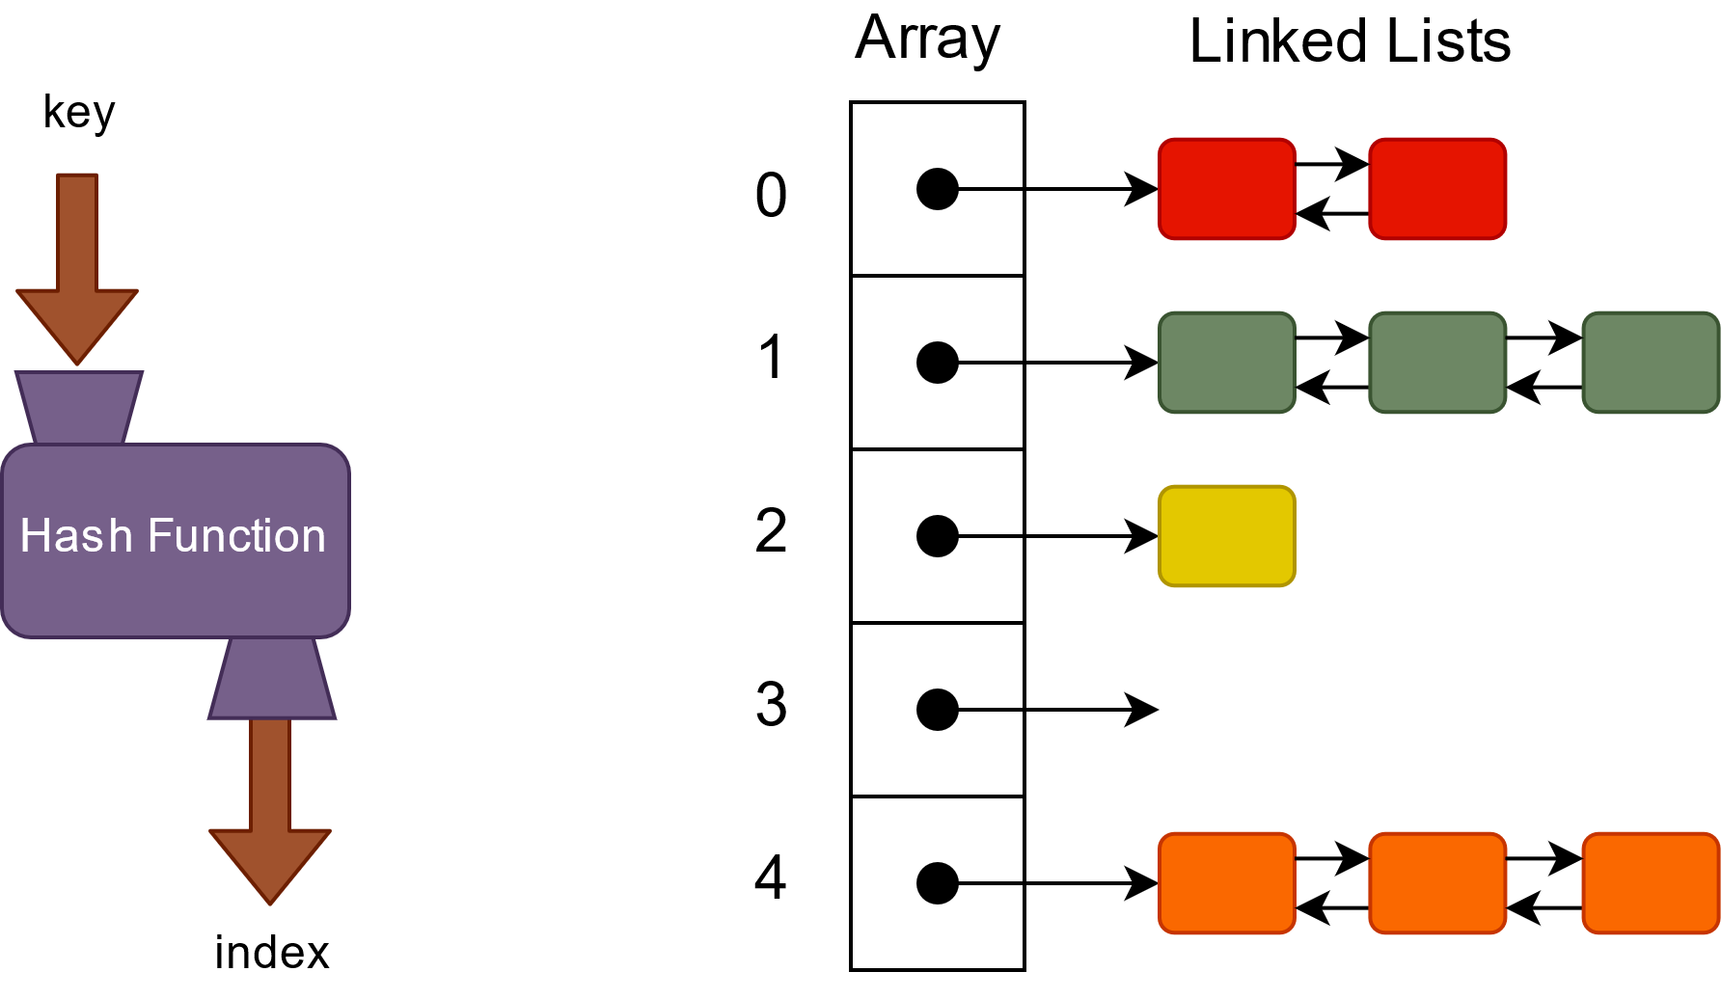
Notes:
In this video, I want to talk about what it takes to implement basic sets and set operations in code. There are several different approaches to implementing sets in code, including arrays and linked lists.
We can use arrays much like we did with stacks or queues, keeping track of the starting and ending locations in the array of the set elements. Of course, arrays also have their drawbacks in that they have a limited capacity and we must explicitly manage that capacity.

Slide 3
prepend
append
insertAt
remove
removeAt
removeLast
reset
getNext
removeCurrent
Notes:
However, in this video, we will implement our set operations on top of a doubly linked list. Linked lists have several efficient operations that we can use to implement sent operations, such as append, list iterator, and remove current.
A linked list, as we have seen, is very general and provides much of what we need.

Slide 4
Hash function should be
Uniform
Efficient
Deterministic
Notes:
A good hash function has three key properties. First, a good hash function is uniform, which means the function should map keys uniformly to the range of array indexes. Second, the function should be efficient. It should be able to be computed quickly. And finally, the function should be deterministic:, which is another way of saying that the hash function should always map a given key to the same index value

Slide 5
Hash function should be
Uniform
Efficient
Deterministic
public int computeIndex(Object key){
return key.hashCode() % this.getCapacity();
}
def compute_index(self, key):
return hash(key) % self.capacity
Notes:
Many modern programming languages provide built-in support for hash functions, including both Java and Python. In both languages, the hash functions can take any object and produce an integer. Our example shows how we can use the Java *hashCode* and the Python *hash* functions. Notice that we still have to use the modulo operator to reduce the size of the hash code returned down to the capacity of our array.

Slide 6
class Tuple
object key = null
object value = null
function Tuple(object k, object v)
key = k
value = v
end function
… getters, toString, equals …
end class

Slide 7
class HashTable
int size
double loadFactor
doubleLinkedList[] hashTable
function HashTable()
hashTable = new doubleLinkedList[16]
for i = 0 to hashTable.length
hashTable[i] = new doubleLinkedList()
end for
size = 0
loadFactor = 0.75
end function

Slide 8
function computeIndex(object key) returns integer
return hashCode(key) % getCapacity()
end function

Slide 9
function put(object key, object value)
index = computeIndex(key)
hashTable[index].reset()
current = hashTable[index].getNext()
while current != null
if current.key == key
current.value = value
return
end if
current = hashTable[index].getNext()
end while
hashTable[index].append(new Tuple(key, value))
size = size + 1
if size/capacity > loadFactor
doubleCapacity()
end if
end function

Slide 10
function put(object key, object value)
index = computeIndex(key)
hashTable[index].reset()
current = hashTable[index].getNext()
while current != null
if current.key == key
current.value = value
return
end if
current = hashTable[index].getNext()
end while
hashTable[index].append(new Tuple(key, value))
size = size + 1
if size/capacity > loadFactor
doubleCapacity()
end if
end function

Slide 11
function put(object key, object value)
index = computeIndex(key)
hashTable[index].reset()
current = hashTable[index].getNext()
while current != null
if current.key == key
current.value = value
return
end if
current = hashTable[index].getNext()
end while
hashTable[index].append(new Tuple(key, value))
size = size + 1
if size/capacity > loadFactor
doubleCapacity()
end if
end function

Slide 12
function put(object key, object value)
index = computeIndex(key)
hashTable[index].reset()
current = hashTable[index].getNext()
while current != null
if current.key == key
current.value = value
return
end if
current = hashTable[index].getNext()
end while
hashTable[index].append(new Tuple(key, value))
size = size + 1
if size/capacity > loadFactor
doubleCapacity()
end if
end function

Slide 13
function put(object key, object value)
index = computeIndex(key)
hashTable[index].reset()
current = hashTable[index].getNext()
while current != null
if current.key == key
current.value = value
return
end if
current = hashTable[index].getNext()
end while
hashTable[index].append(new Tuple(key, value))
size = size + 1
if size/capacity > loadFactor
doubleCapacity()
end if
end function

Slide 14
function put(object key, object value)
index = computeIndex(key)
hashTable[index].reset()
current = hashTable[index].getNext()
while current != null
if current.key == key
current.value = value
return
end if
current = hashTable[index].getNext()
end while
hashTable[index].append(new Tuple(key, value))
size = size + 1
if size/capacity > loadFactor
doubleCapacity()
end if
end function

Slide 15
Performance
Best Case – Constant Time!
Hash Function Properly Distributes Keys
Each List (Bucket) Has Few Elements

Slide 16
Performance
Best Case – (Nearly) Constant Time!
Hash Function Properly Distributes Keys
Each List (Bucket) Has Few Elements
Worst Case – Order N Time
Hash Function Puts in Same List
Must Iterate Through Entire List

Slide 17
function get(object key) returns object
index = computeIndex(key)
hashTable[index].reset()
current = hashTable[index].getNext()
while current != null
if current.key == key
return current.value
end if
current = hashTable[index].getNext()
end while
return null
end function

Slide 18
function remove(object key) returns object
index = computeIndex(key)
hashTable[index].reset()
current = hashTable[index].getNext()
while current != null
if current.key == key
hashTable[index].removeCurrent()
size = size – 1
return current.value
end if
current = hashTable[index].getNext()
end while
return null
end function

Slide 19
function copy() returns HashTable
HashTable copy = new HashTable()
for i = 0 to getCapacity()
hashTable[i].reset()
current = hashTable[i].getNext()
while current != null
copy.put(current.key, current.value)
current = hashTable[i].getNext()
end while
end for
return copy
end function

Slide 20
function doubleCapacity()
capacity = capacity * 2;
doubleLinkedList[] newTable
for i = 0 to getCapacity()
newTable[i] = new doubleLinkedList()
end for
for i = 0 to getCapacity() / 2
hashTable[i].reset()
current = hashTable[i].getNext()
while current != null
index = computeIndex(current.key)
newTable[index].append(current)
current = hashTable[i].getNext()
end while
end for
hashTable = newTable
end function

Slide 21
Notes:
In this video, I want to talk about what it takes to implement basic sets and set operations in code. There are several different approaches to implementing sets in code, including arrays and linked lists.
We can use arrays much like we did with stacks or queues, keeping track of the starting and ending locations in the array of the set elements. Of course, arrays also have their drawbacks in that they have a limited capacity and we must explicitly manage that capacity.

