Slide 1

Sets with Hash Tables
Computational Core

Slide 2
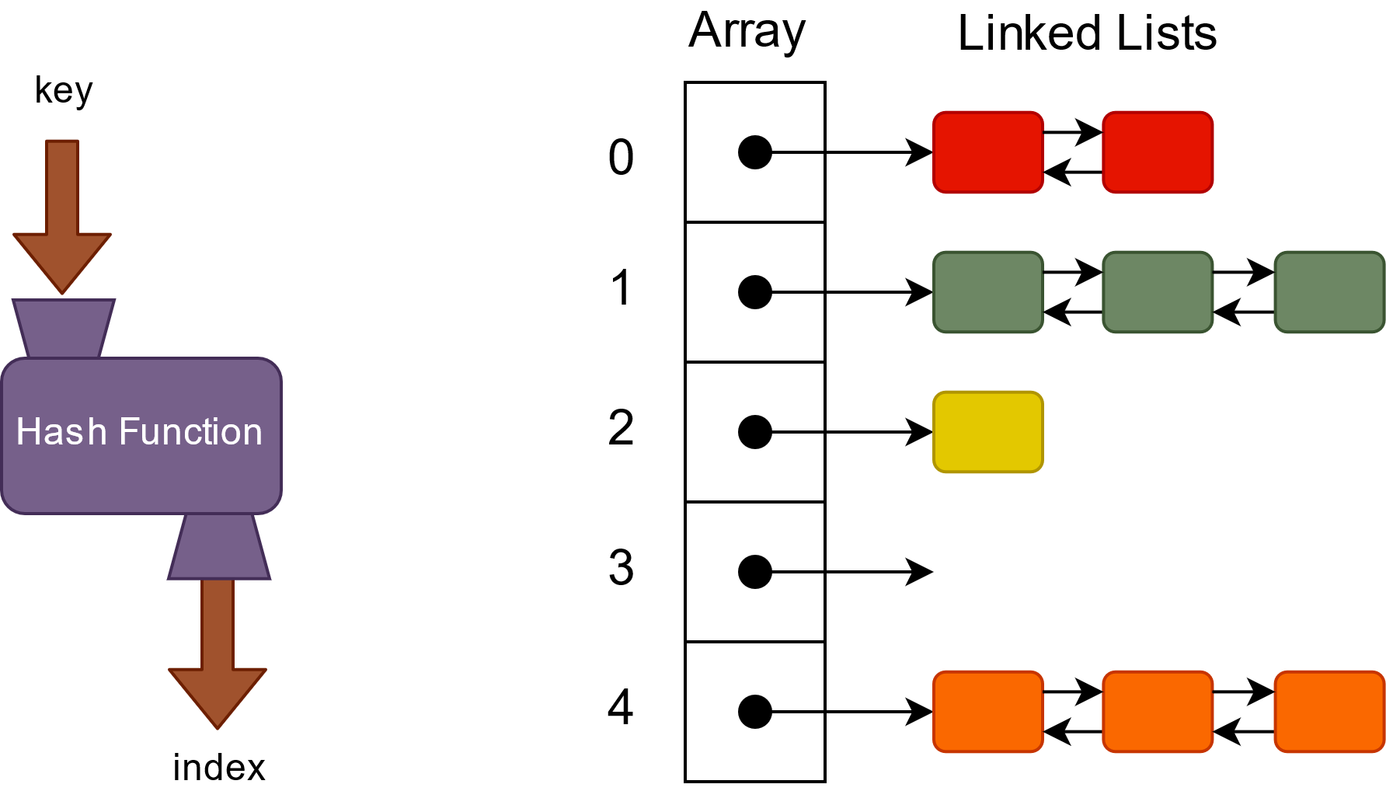

Slide 3
Hash Tables as Sets
Keys must be unique anyway
contains operation is fast!
Constant time in best case
Other operations easy to implement
mySet = new HashTable()

Slide 4
Contains
function contains(object o) returns boolean
return mySet.containsKey(o)
end function
Constant Time in best case!

Slide 5
Add
function add(object o) returns boolean
if mySet.containsKey(o)
return false
end if
mySet.put(o, o)
return true
end function
Constant Time in best case!

Slide 6
Remove
function remove(object o) returns boolean
return mySet.remove(o) != null
end function
Constant Time in best case!

Slide 7
Intersection
function intersection(set1, set2) returns set
result = new Set() (1)
set1.reset() (2)
current = set1.getNext() (3)
while current != null (4)
if set2.contains(current.getKey()) (5)
result.add(current.getKey()) (6)
end if
current = set1.getNext() (7)
end while
return result (8)
end function

Slide 8
Hash Tables as Sets
Most core operations run in constant time!
More complexity → Better Performance

