Slide 1

Control Flow, I/O, Exceptions
Computational Core
Notes:
The first two modules in CC 310 will basically be a review of the important topics covered in CC 210. If you recently completed CC 210 and did well, this material should be fairly easy to go through at a rather quick pace. For others that encountered a few struggles in CC 210, these modules will be a great opportunity to target specific concepts and areas where you need to do a little more work. And for some of you who had an introductory programming course over a semester ago, this will be a really good opportunity for you to refresh your knowledge and make sure you remember the concepts that will be necessary to successfully complete CC 310.
The first module will focus on the essentials for writing code, which including basic topics such as variables, control flow, input and output and exceptions.

Slide 2
Review of CC 210 concepts
Flowcharts and pseudocode
Running programs in Codio
Variables
Conditional statements
Loops
Arrays and lists
Character strings
Exception handling
Notes:
More specifically, this module will start with a brief refresher over abstract representations of programs such as flowcharts and pseudocode as well as providing a brief tutorial over how to run programs in the Codio environment. Next, you will get to look at the basic programming concepts such as variables and important programming structures such as conditional statements and loops. We will also cover the basic data types in including arrays, lists, and character strings. Finally, we will finish by talking about how we can handle exceptions that occur in our programs.

Slide 3
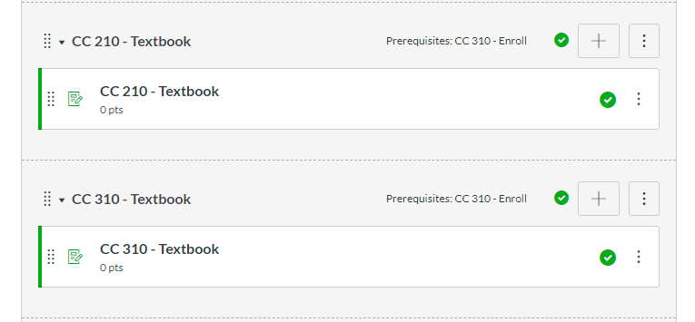
Do I have to?
Exercise 1 and 2 are required
Review sections as needed
Refer to CC 210 for more
Notes:
Now you may be asking yourself, just exactly what do I have to do to get through the review? For Module 1, you must successfully complete both exercises 1 and 2. You’ll also notice that there are no solutions given for these exercises. We’ve done this on purpose. If you cannot successfully complete exercises 1 and 2 on your own, it is probably a good sign that there are one or more concepts from this module that you do not fully understand. If that is the case, do not try to simply muddle through by asking other people to help you complete the exercises or searching the internet for similar code. If you want to be successful in CC 310 it is imperative that you understand the material from this module.
By going through the topics in this module, you should be able to refresh your memory and determine your level of comfort with each area. If you find you really do understand the concepts, feel free to push onward. However, if you find topics that you do not feel very comfortable with, I urge you to take time now to go back and review the topics in more depth to make sure you have a solid foundation. Programming is a lot like math. If you don’t really understand how to add two numbers, it will be almost impossible for you to be able to do even the simplest multiplication. The same is true in programming. Concepts tend to build on each other and it is essential you master the basics.
If you are having trouble, feel free to go back to the CC 210 textbook to review the concepts in more depth. You can access the CC 210 textbook through the "CC 210 Textbook" module in Canvas. You can find it right below this introductory module.

