Slide 1

Choosing Data Structures
Computational Core

Slide 2
So Many Data Structures…
Arrays
Stacks
Queues
Linked Lists
Hash Tables
Sets

Slide 3
How to Choose the Right Structure?

Slide 4
How to Choose the Right Structure?
Does it work?

Slide 5
How to Choose the Right Structure?
Does it work?
Is it Understandable?

Slide 6
How to Choose the Right Structure?
Does it work?
Is it Understandable?
Is it Performant?

Slide 7
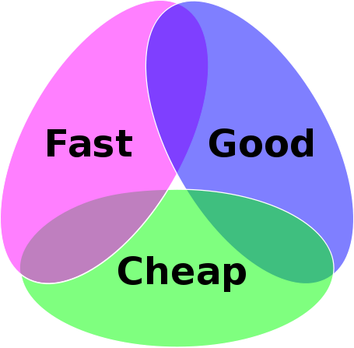

Slide 8
Good + Fast: Hash Table?

Slide 9
Fast + Cheap: Array?

Slide 10
Good + Cheap: Linked List?

