Slide 1

Arrays Performance
Computational Core

Slide 2
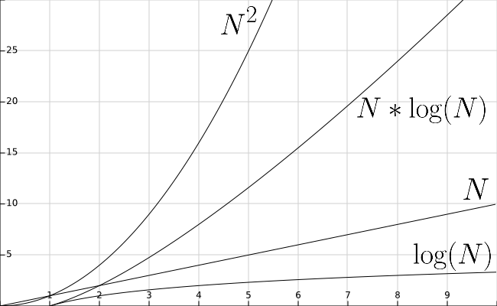

Unsorted Array
 | Best | Worst
Insert | 1 | 1
Access | 1 | 1
Find | N | N
Delete | N | N

Slide 3

Sorted Array
 | Best | Worst
Insert | lg(N) | N
Access | 1 | 1
Find | lg(N) | lg(N)
Delete | lg(N) | N

Slide 4
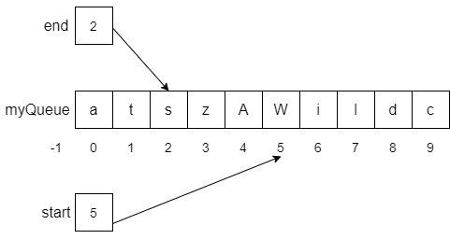
Array Stack & Queue
 | Best | Worst
Insert | 1 | 1
Access | 1 | 1
Find | N | N
Delete | 1 | 1

