Slide 1

Lists Performance
Computational Core

Slide 2
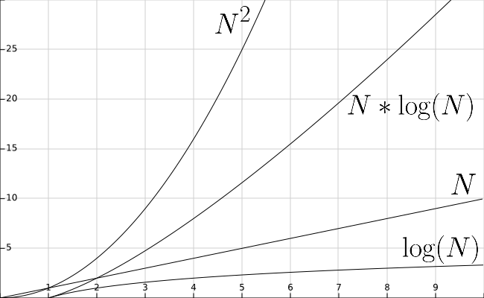
Unsorted Linked List
 | Best | Worst
Insert | 1 | 1
Access | N | N
Find | N | N
Delete | N | N

Slide 3
Sorted Linked List
 | Best | Worst
Insert | N | N
Access | N | N
Find | N | N
Delete | N | N

Slide 4
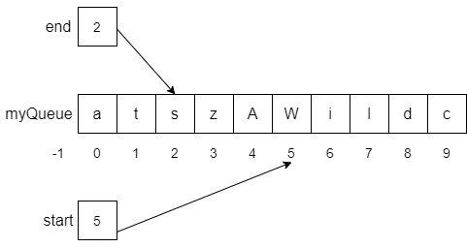
List Stack & Queue
 | Best | Worst
Insert | 1 | 1
Access | 1 | 1
Find | N | N
Delete | 1 | 1

