Slide 1

Hash Table Performance
Computational Core

Slide 2
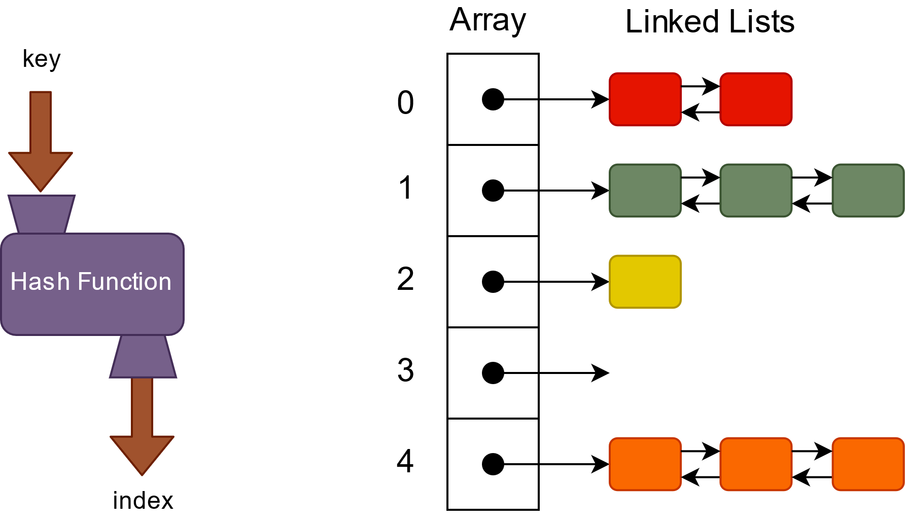
Hash Table
 | Best | Worst
Insert | 1 | N
Access | 1 | N
Find | N | N
Delete | 1 | N

