Slide 1

Algorithm Performance
Computational Core

Slide 2
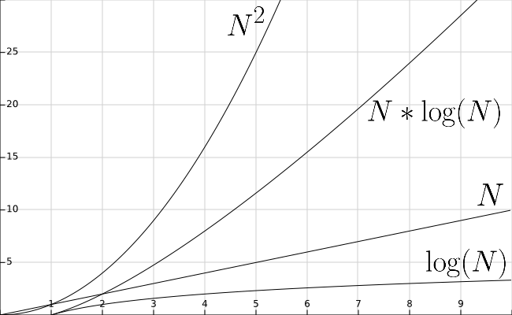
Algorithms
 | Best | Worst
Linear Search | N | N
Binary Search | lg(N) | lg(N)
Selection Sort | N² | N²
Bubble Sort | N² | N²
Merge Sort | N lg(N) | N lg(N)
Quick Sort | N lg(N) | N²

