Slide 1
FTC Web App
By: Rana Chevuru

Slide 2
Discussion Topics
Why FTC
Tools used
MVP
1.0
2.0
TimeLine

Slide 3
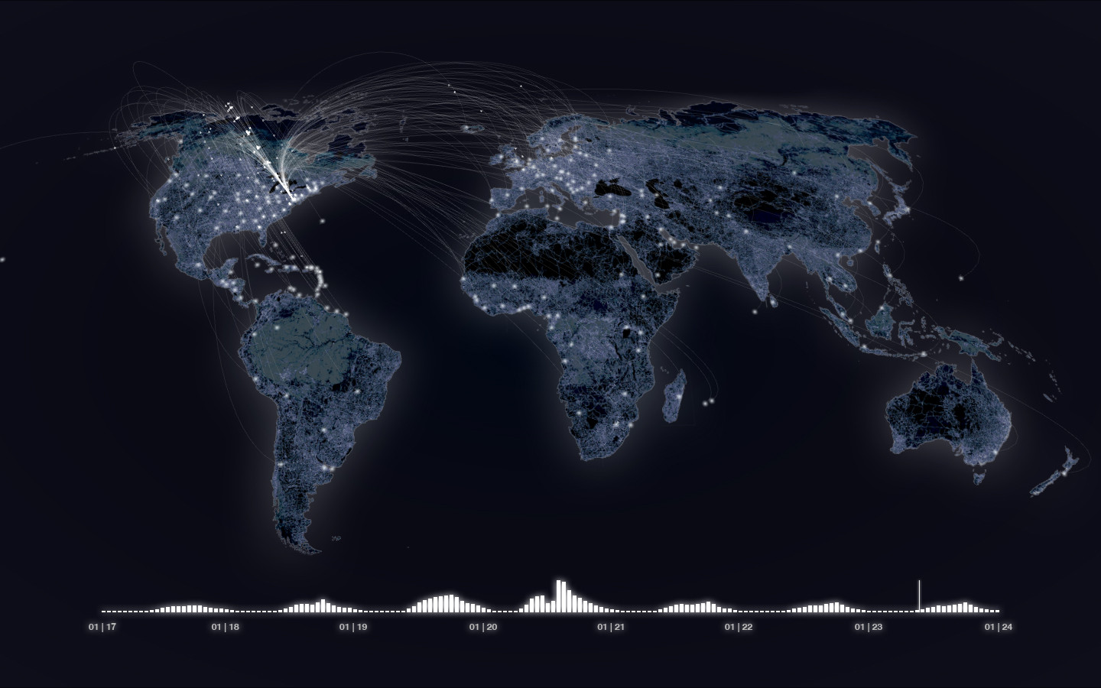
Why did I choose this data
Notes:
I chose this data since it looked interesting when I first looked at it, and because I wanted to incorporate big data somehow into my project. Not only did I choose this dataset for those reasons, but I also chose this dataset since it helps the common people to understand the world in a better place. I mean by visualizing showing the data I can allow the people to see what is traded in the world, and if use this with the current we can see how dreadful or delightful the current news is to the world.

Slide 4






How I am planning to visualize the data

Slide 5
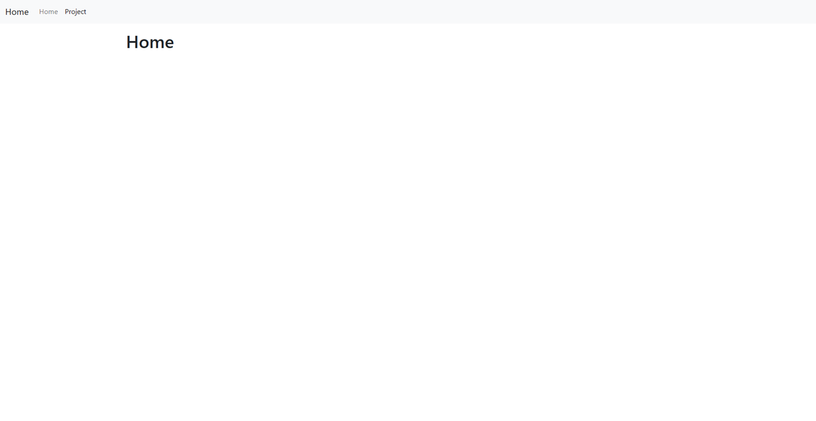
Design Layout

Slide 6
MVP
Display the world map
Have inputs filters (country, product, Restriction, and country partners)
Make a popup screen
Display the countries being traded

Slide 7
1.0
Implement intensity of trade
Create a visual for the products being traded by each country
Adding restrictions

Slide 8
2.0
Add React
Clean the Web App
Do AI classification
Web App accessible from phone

Slide 9
Timeline
Start on version 1.0
Week 9
Week 15
Week 10
MVP Done
Version 1.0 Done/clean up

Slide 10
Questions

