Slide 1
FTC Web App
By: Rana Chevuru

Slide 2
Agenda
Brief Overview
Fun diagrams
Testing

Slide 3






Quick Overview
Notes:
As you know my project is very conveniently named FTC Web App, which describes my project. I am using Flask, Python, Bootstrap, Pandas, HTML, and Plotly to display my data for the web site

Slide 4
Fun Diagrams

Slide 5
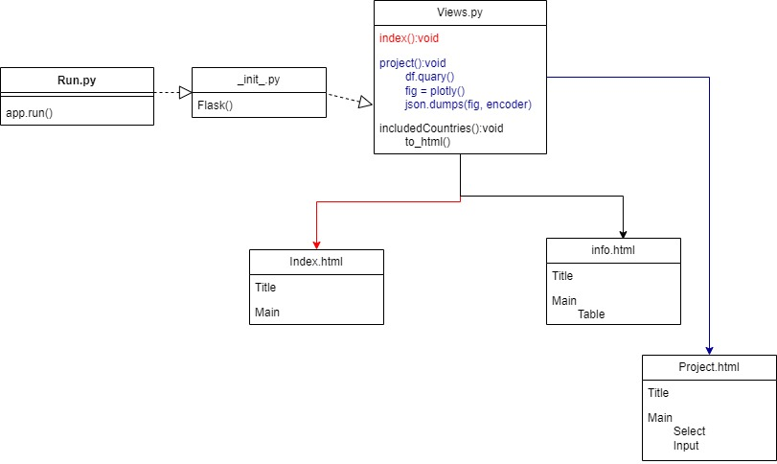
Component Diagram for whole Project

Slide 6
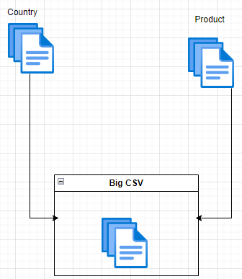
Component Diagram
Notes:
Using glob glob and os path join

Slide 7
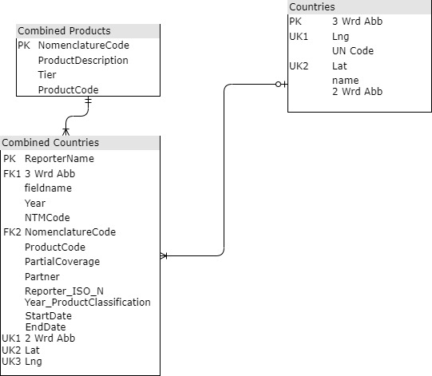
DB Diagram
Notes:
I am not using a db for this project. I am just doing a df, but I am treating it has a db. Therefore, I am just representing it like this. Also, the joining of this is not that simple to

Slide 8
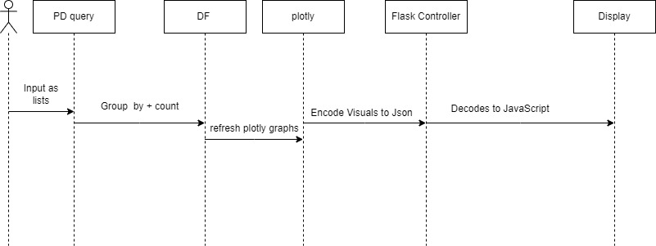
Sequence Diagram

Slide 9
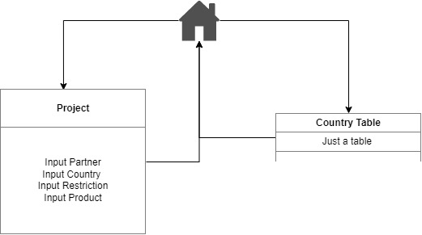
Site Map

Slide 10
Testing
Test Cases
User Testing
Browser Testing
Notes:
Testing with these… My test cases are written down so I can test them, but they are not unix test cases.

