Slide 1
ROS Command

Slide 2
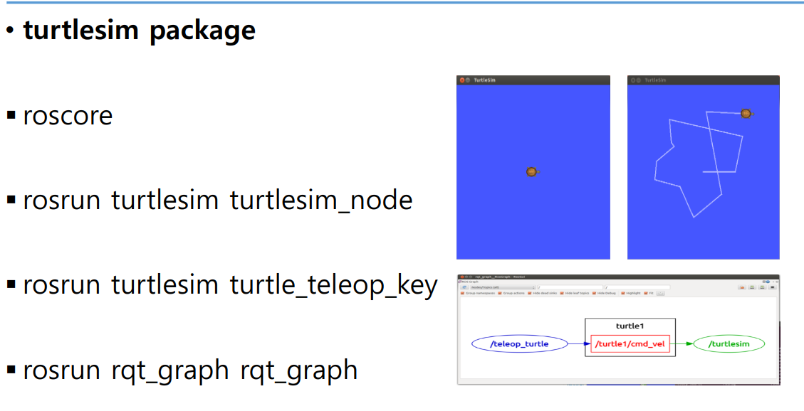

Slide 3
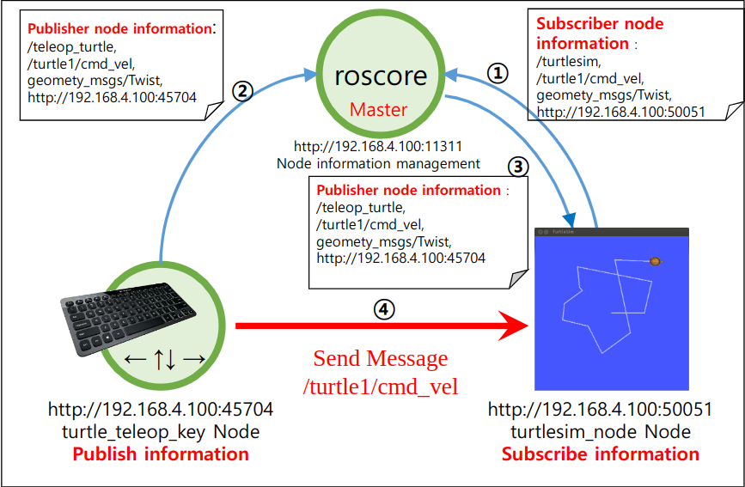

Slide 4
Ubuntu System
ROS Core Workspace
(sudo apt install ros**)
Package List
(nano ~/.bashrc)
source /opt/ros/melodic/setup.bash
source /home/helium/Documents/ros_ws/devel/setup.bash
Custom Workspace
(user define [catkin make*])
Find Packages
Do Something

Slide 6
roscore
rosrun turtlesim turtlesim_node
turtlesim?
turtlesim_node?
turtle_teleop_key?
Custom Workspace
rosrun turtlesim turtle_teleop_key
Core Workspace
rqt_graph?
rqt_graph?
rosrun rqt_graph rqt_graph

