Slide 1


Team 3 Iteration 1 Report
Team Leader: Joseph Trussell
Team Members: Tyler Wells & Tylor Bricker

Slide 2
Team 3 [DIO]
Our job for iteration 1 was to make the models, visuals and sounds for the first sub game, Xeonic Fleet, as well as getting started on those same things for the main game lobby.

Slide 3
Iteration 1 goals
Create and implement all models for subgame 1: Xeonic Fleet
Find/create and implement all music and sound effects for subgame 1
Create logo and arcade machine for subgame 1
Start finding/creating models, sounds logos, characters and cinematics for main game lobby

Slide 4
Tickets Week 1
Main Game
Arcade machine main model
Arcade machine textures
Main Logo
Posters (game posters)
Main Menu Music (Version 1)
Stretch Goal: Main Lobby Music
Sub Game 1
Base Ship Model
Space Logo
Space Background
Sound Effects
Stretch Goal: Space Theme music

Slide 5

Tickets Week 2
Main Game:
8: Main Logo
96: Poster 1
95: Machine Texture 1
4: Lobby Music
Sub Game:
82: Secondary Ship Model
83: Base ship model
79: Flying sounds
80: Destruction sounds
85: Space Logo
78: BackGround Music
81: Enemy Models

Slide 6
Tickets Week 3
Main Game:
Main Logo #8 estimated 2 days
misc Models #69 estimated ongoing (will break down to other models)
Poster 1 #96 estimated 1 day
Lobby Music #4 estimiated 1 - 5 days
SubGame:
impletment models #137 estimated 1 day
impletment sounds #138 estimated 1 day
implement text #139 estimated 1 day

Slide 7
Joseph Trussel: Modeling
Blender Modeling
3d models, textures made from scratch
Model Implementation

Slide 8

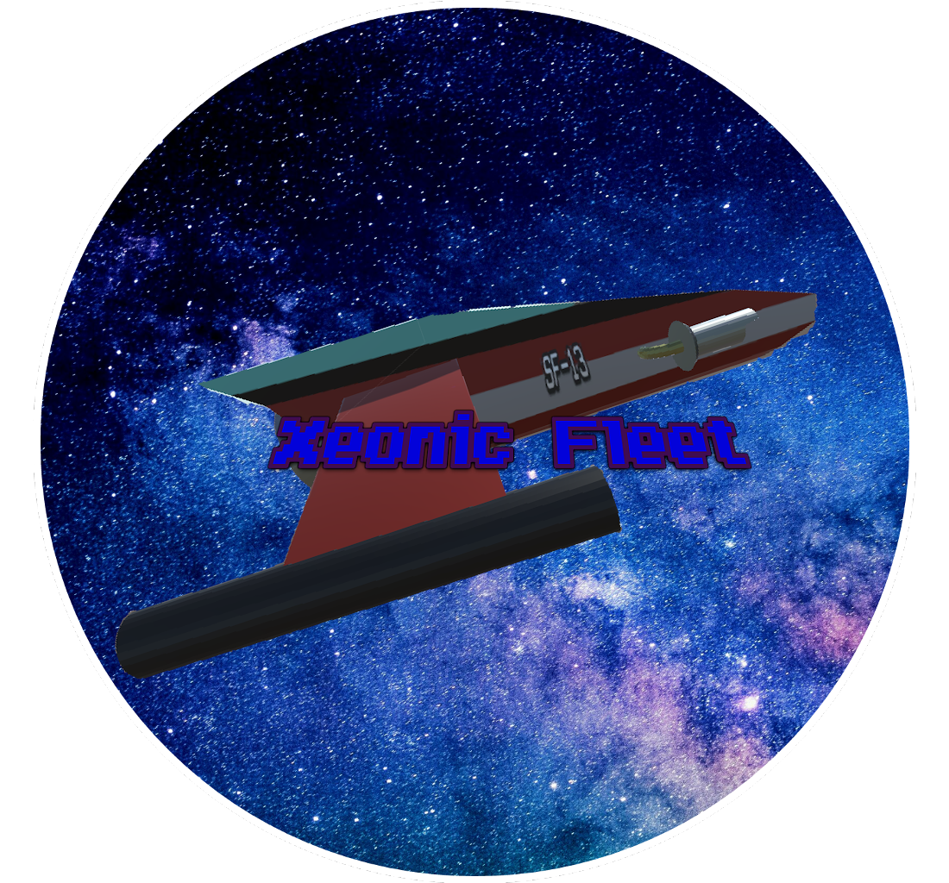
Tylor Bricker:
2D artwork
Logos

Slide 9
Tyler Wells: Music and Sounds
Creation/acquisition of music and sounds
Implementation of sound effects and music for subgame 1

Slide 10
Uncompleted Tickets
Lobby Music:
Subgame 1 powerup/asteroid models
Xeonic Fleet animations

Slide 11
Iteration Risks
1.) Missing textures (have to make sure ounce textures are set to matirials they are not moved)
2.) Models not ligning up right (example the laset comes out of the nose an not the gun)
3.) Music playing out of sync (not looping correctly)
4.) Images be incompatible with engine (chances of this are very low)

