Slide 1
Weather Data Science
Step 1: Gather Data

Slide 2
Icebreaker!
What is the coolest or most interesting weather phenomenon you’ve ever experienced?
What is so memorable about it?

Slide 3
When should I plant corn and soybeans? How does the growing season for crops vary across Kansas?

Slide 4
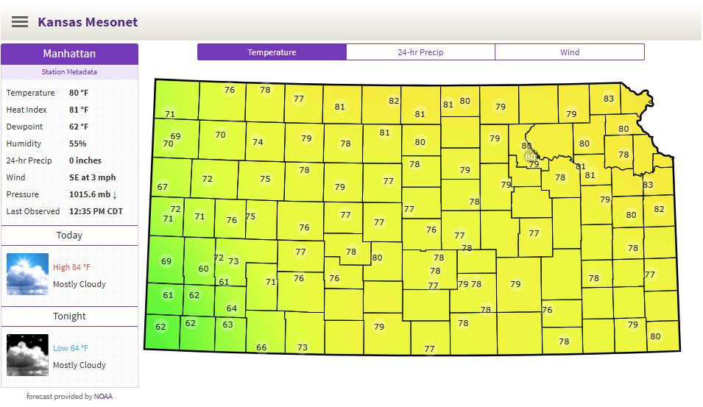
We need data!

Slide 5
Kansas Mesonet
K-State Research & Extension Weather Stations
Established in 1986
Hourly and Daily Data available for many years
https://mesonet.k-state.edu/

Slide 6
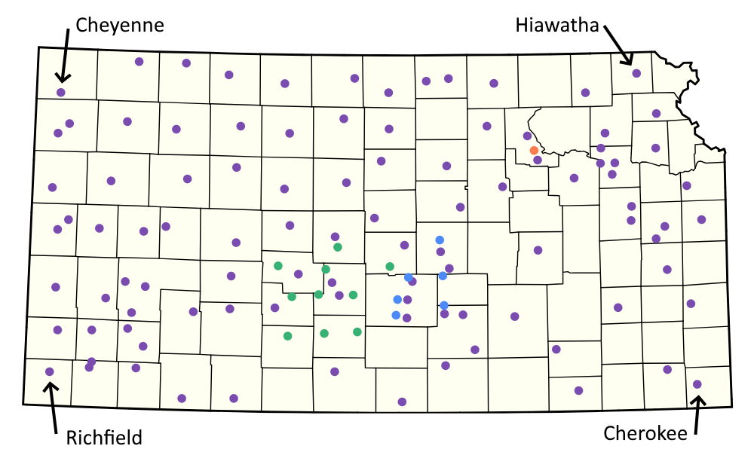

Slide 7
Gather Data
Choose Cheyenne (Northwest Corner)
Date Range: 2025-01-01 through 2025-12-31
Daily Data
Export as CSV
Repeat for other corners of Kansas

Slide 8
