Slide 1
Weather Data Science
Step 2: Clean Data

Slide 2
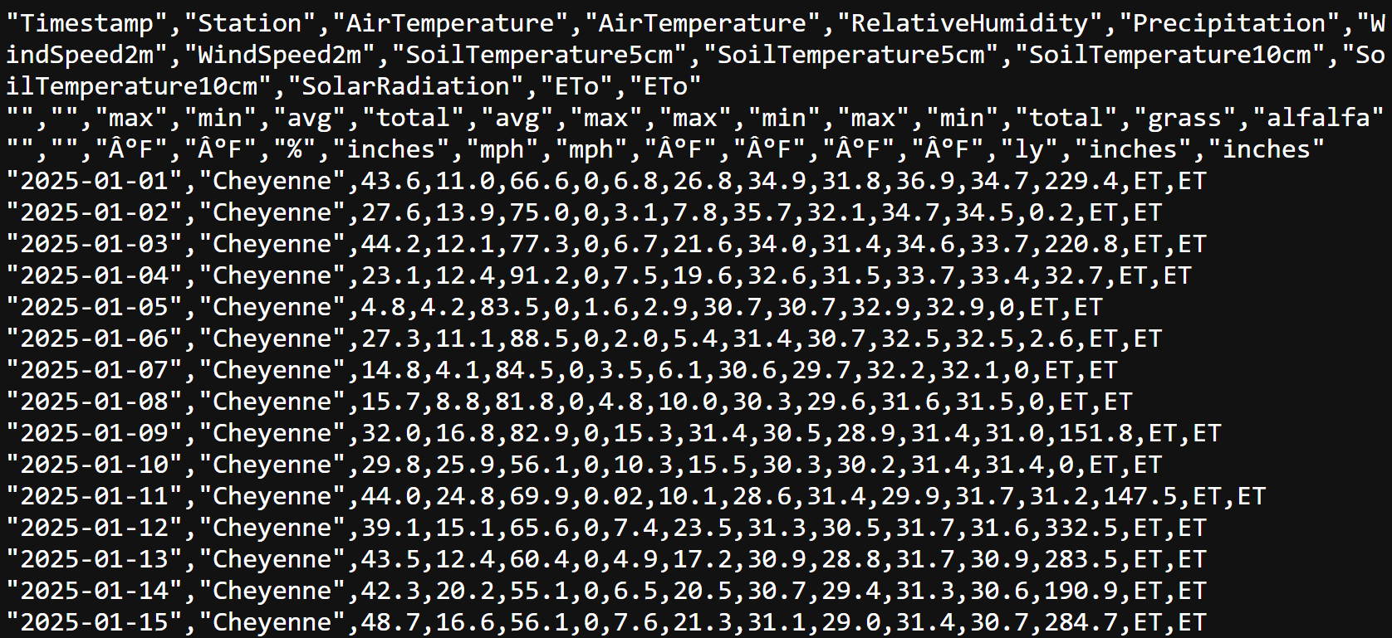

Slide 3
First – Data Cleanup!
Remove Bad Header Lines
Add Corrected Header
Convert Date to Day of Year
Remove Unused Data Columns
Write to New File
See `clean_data.py` file

Slide 4
Run Data Cleanup Script
python3 clean_data.py cherokee.csv cheyenne.csv hiawatha.csv richfield.csv

