Slide 1
Weather Data Science
Step 3: Graph Data

Slide 2
Now Let’s Analyze Data!
Tools:
Visual Studio Code
Python
Jupyter Notebooks
Plotly Express, Numpy & Pandas Libraries

Slide 3
Getting Started – Install Python Libraries
pip install –r requirements.txt

Slide 4
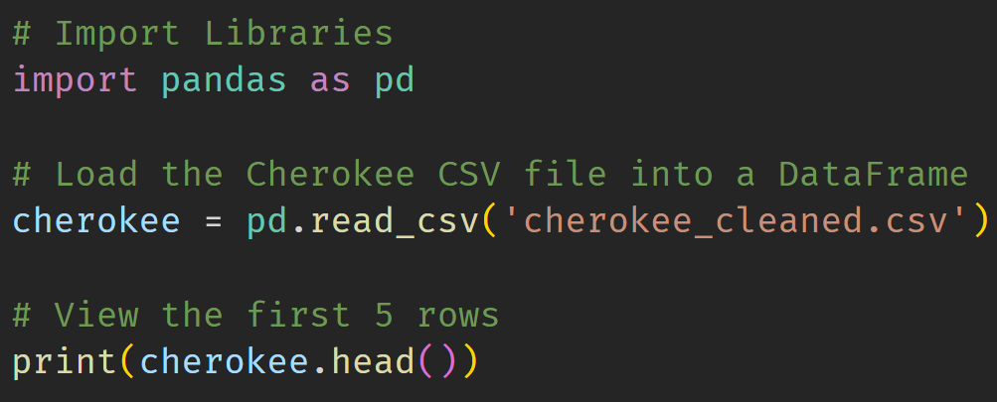

Slide 5
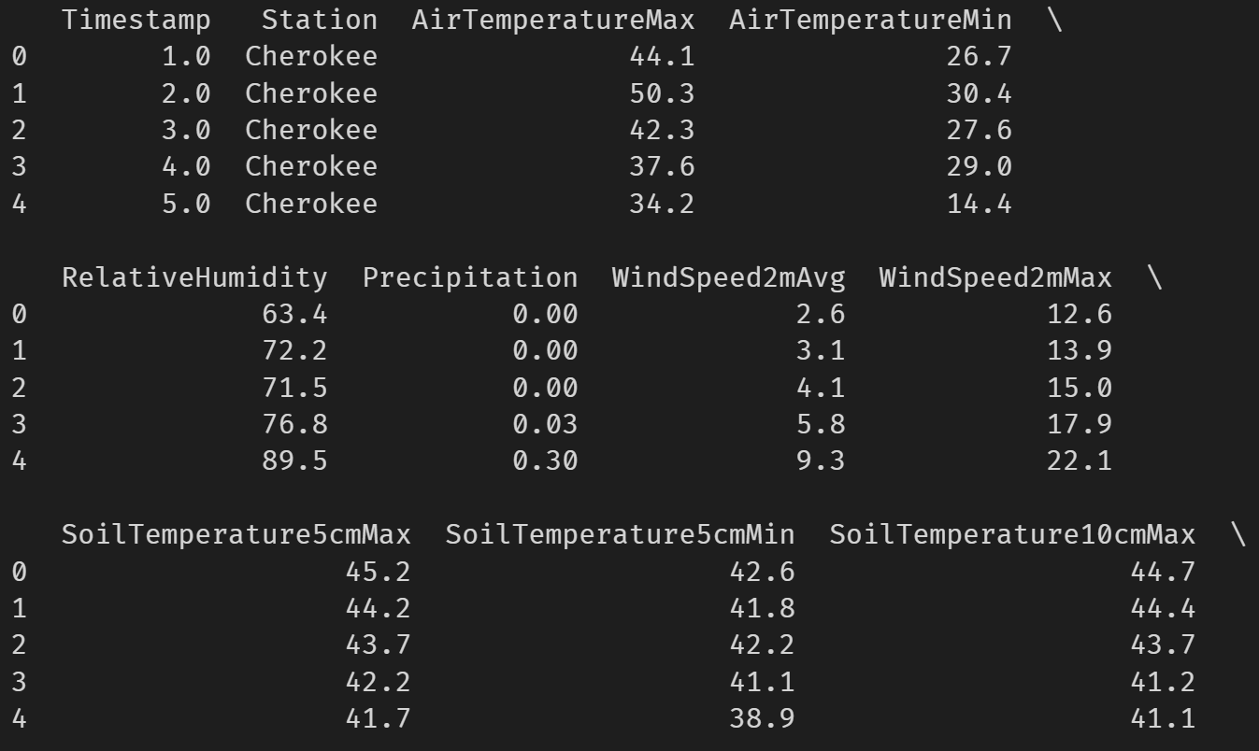

Slide 6
Create your First Graph!
We’ll use a Line Graph
X Axis – Timestamp (Day of Year)
Y Axis – Min Soil Temperature 2” Depth

Slide 7
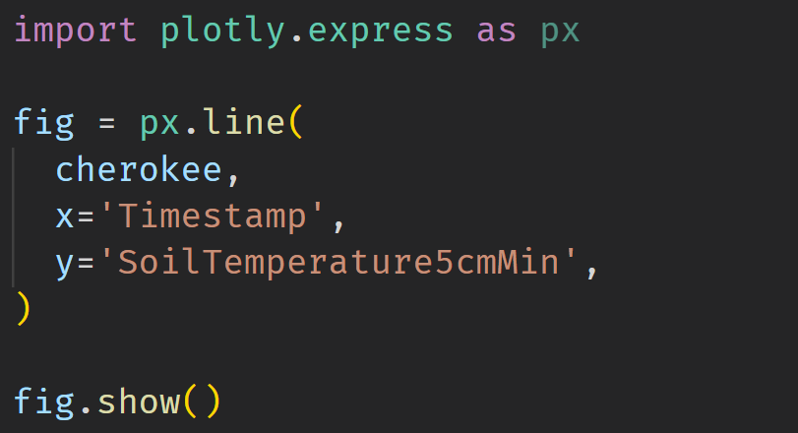

Slide 8
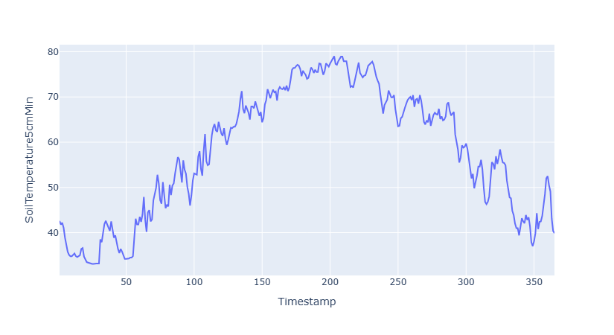

Slide 9
Let’s Add Some More Data!
Graph the Min and Max Soil Temp
Add some labels!

Slide 10
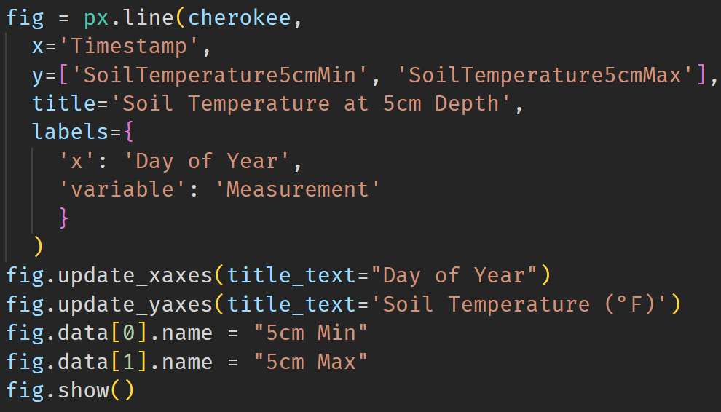

Slide 11
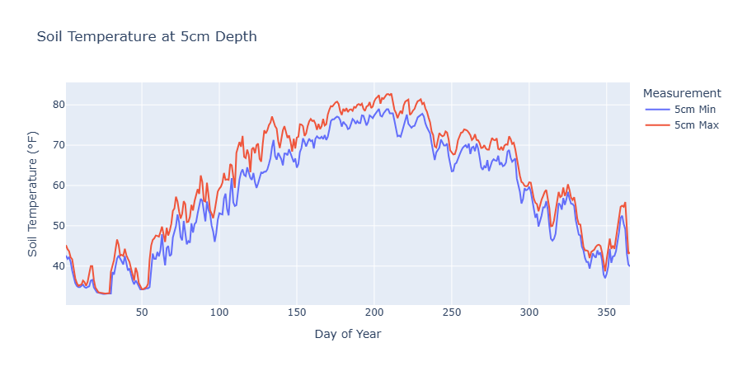

Slide 12
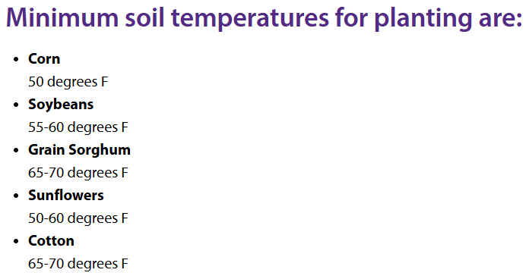
When should I plant corn and soybeans?
https://www.riley.k-state.edu/crops-livestock/soils-and-crops/cropplantingtemps/

Slide 13
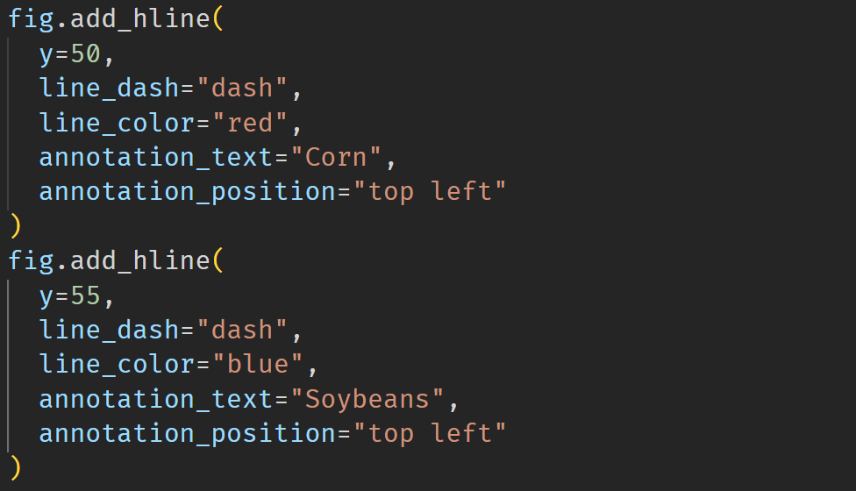

Slide 14
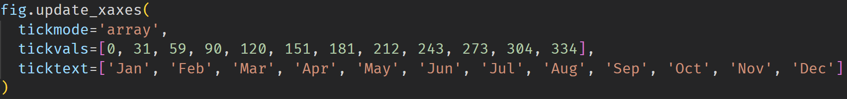

Slide 15
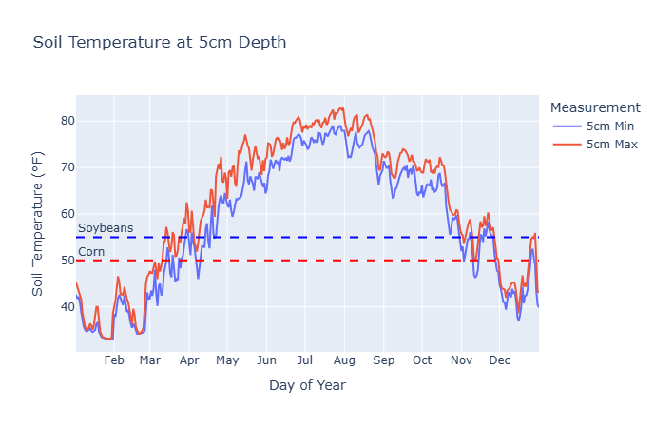

Slide 16
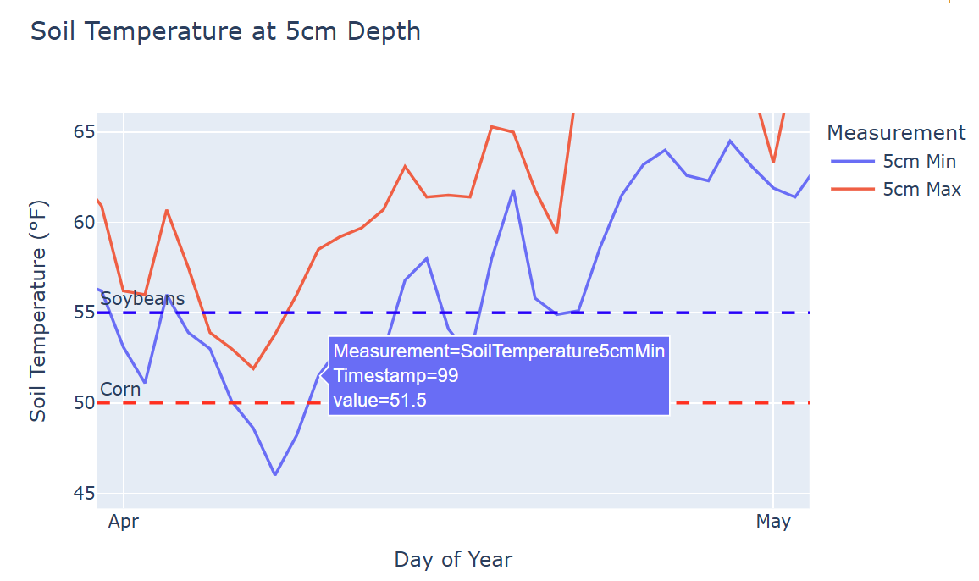

Slide 17
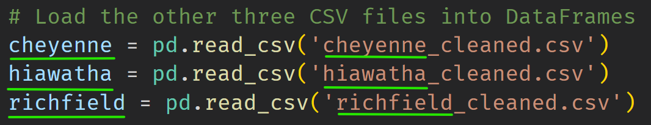
Let’s Load The Rest of our Data!

Slide 18
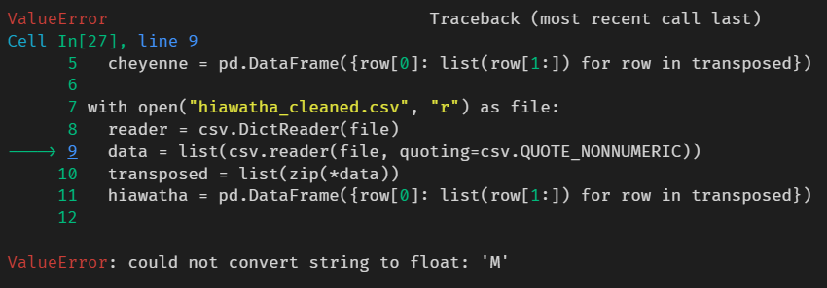
Error!

Slide 19
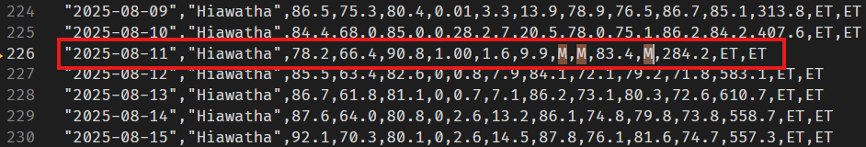
M = Missing Data
How should we deal with missing data?

Slide 20
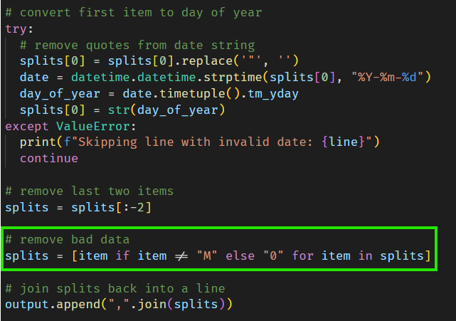
Update `clean_data.py`

Slide 21
Re-run Data Cleanup Script
python3 clean_data.py cherokee.csv cheyenne.csv hiawatha.csv richfield.csv
Then re-run latest code block!

Slide 22
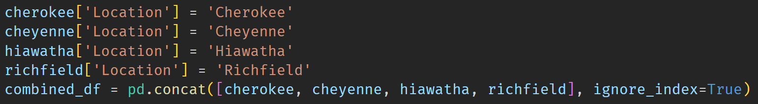
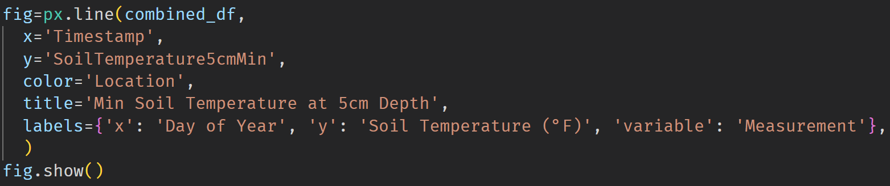
Combine Data Frames & Graph It!

Slide 23
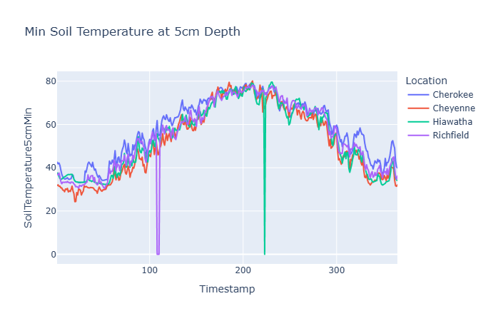

Slide 24
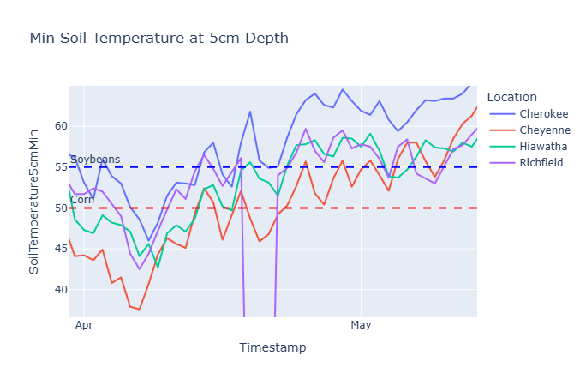

Slide 25
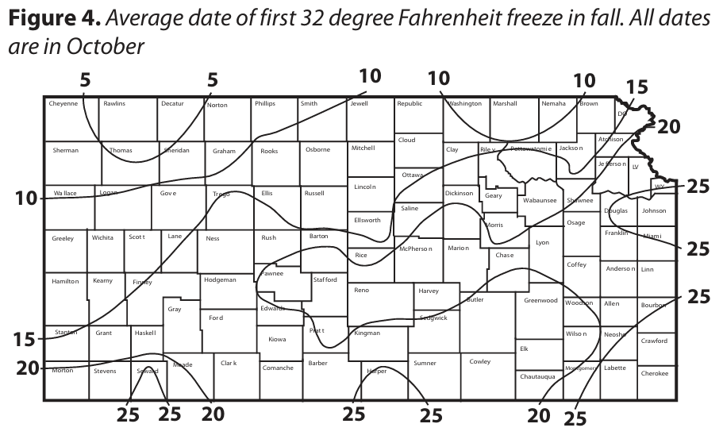
How does the growing season for crops vary across Kansas?
https://mesonet.k-state.edu/agriculture/degreedays/c560.pdf

Slide 26
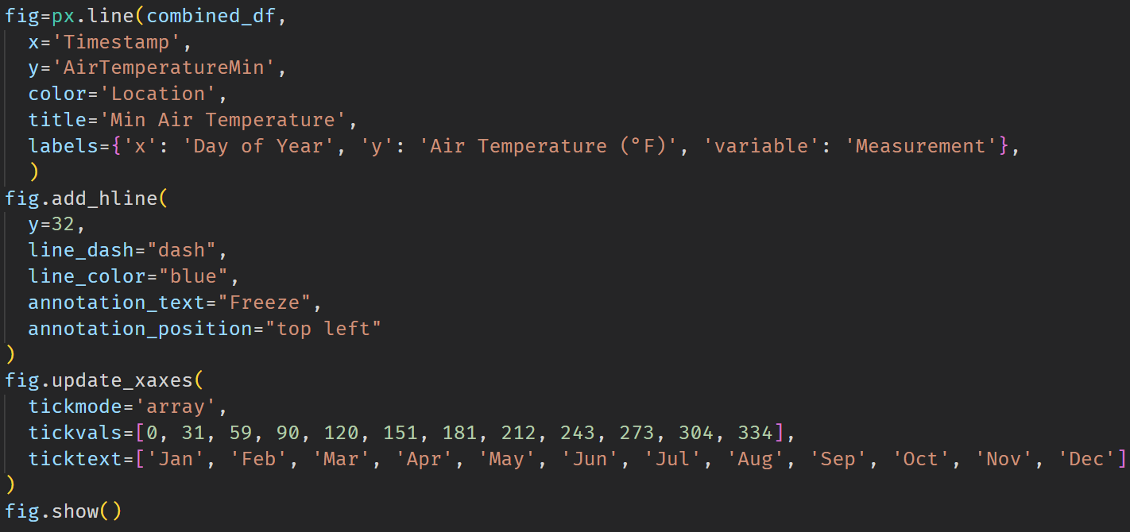
First Freeze!

Slide 27
