Slide 1
Weather Data Science
Step 4: Machine Learning

Slide 2
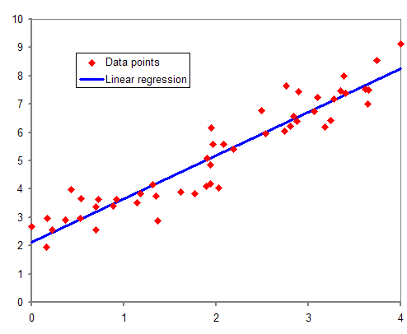
Predicting Data – Linear Regression

Slide 3
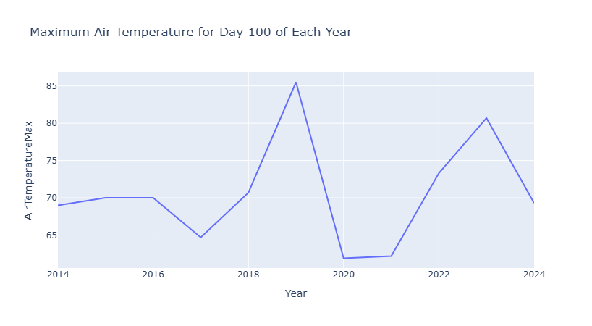

Slide 4
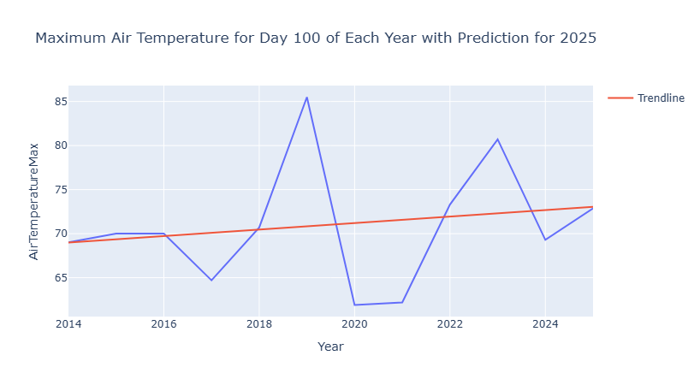

Slide 5
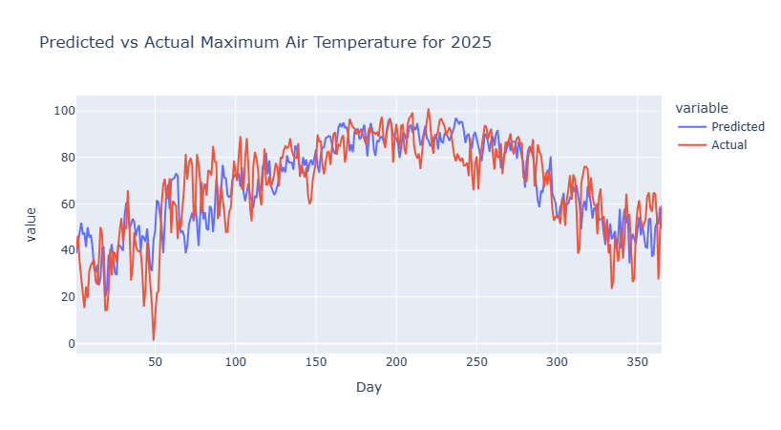

Slide 6
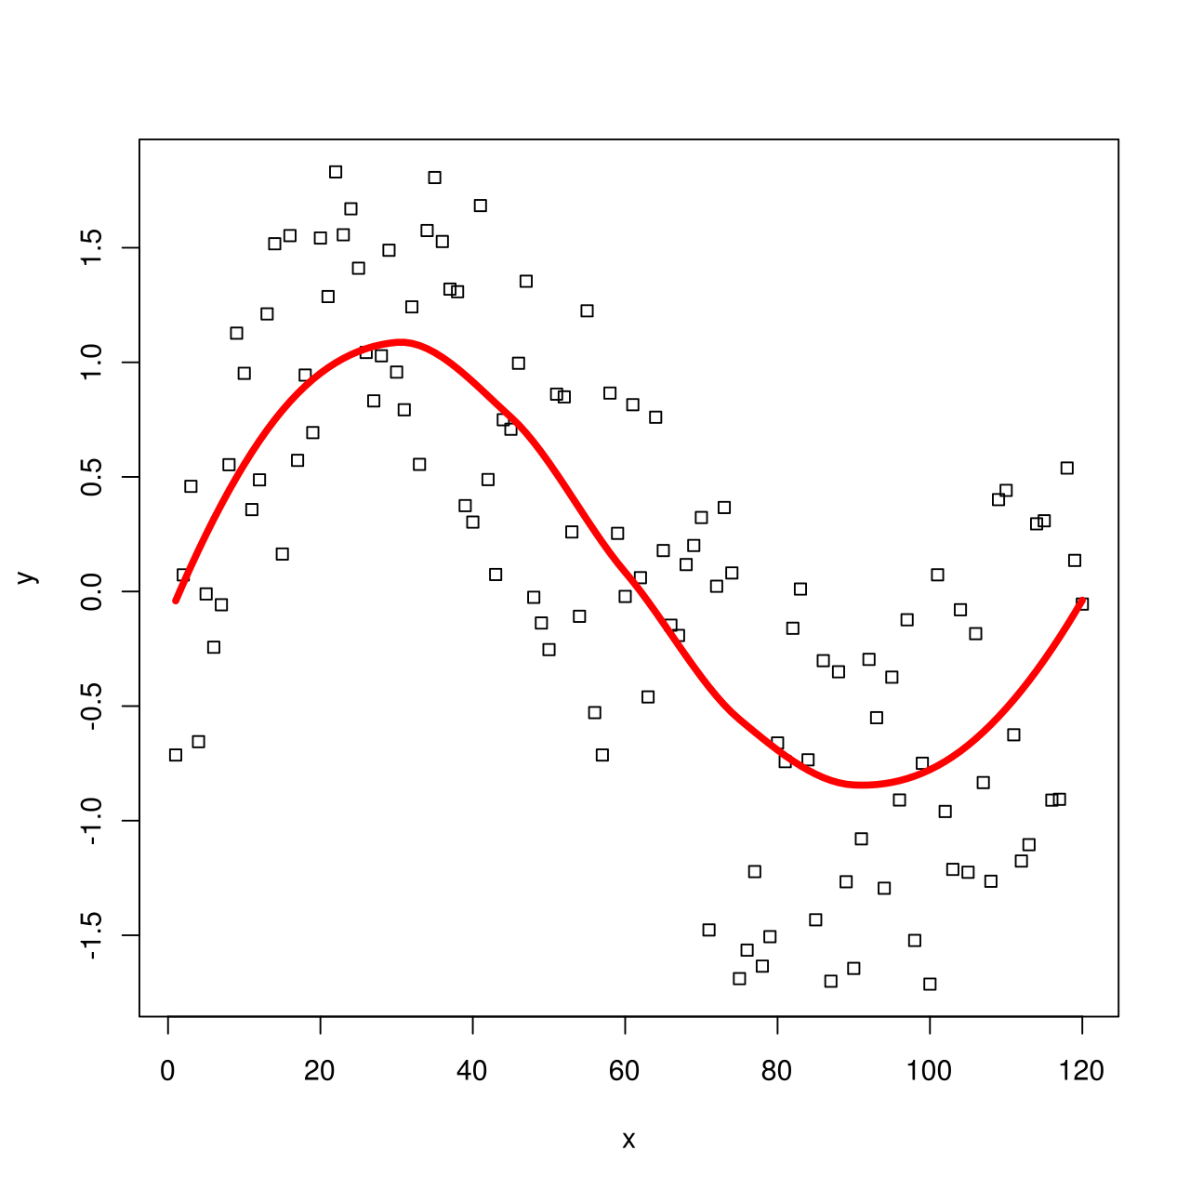
Predicting Data – Polynomial Regression

Slide 7
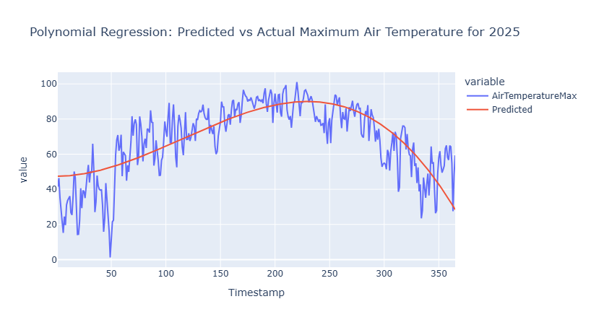

Slide 8
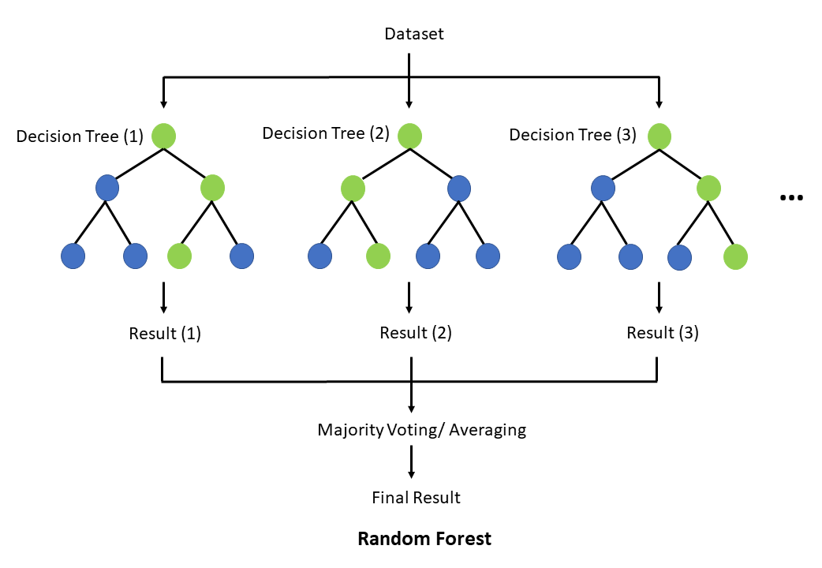
Predicting Data – Random Forest

Slide 9
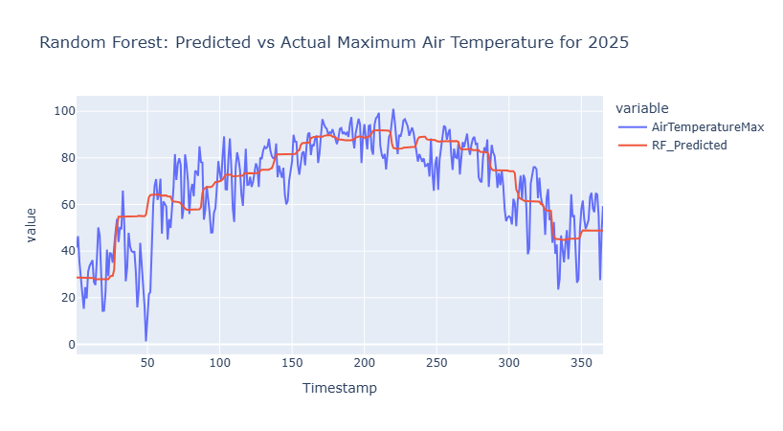

Slide 10

Questions & Answers

