Slide 1

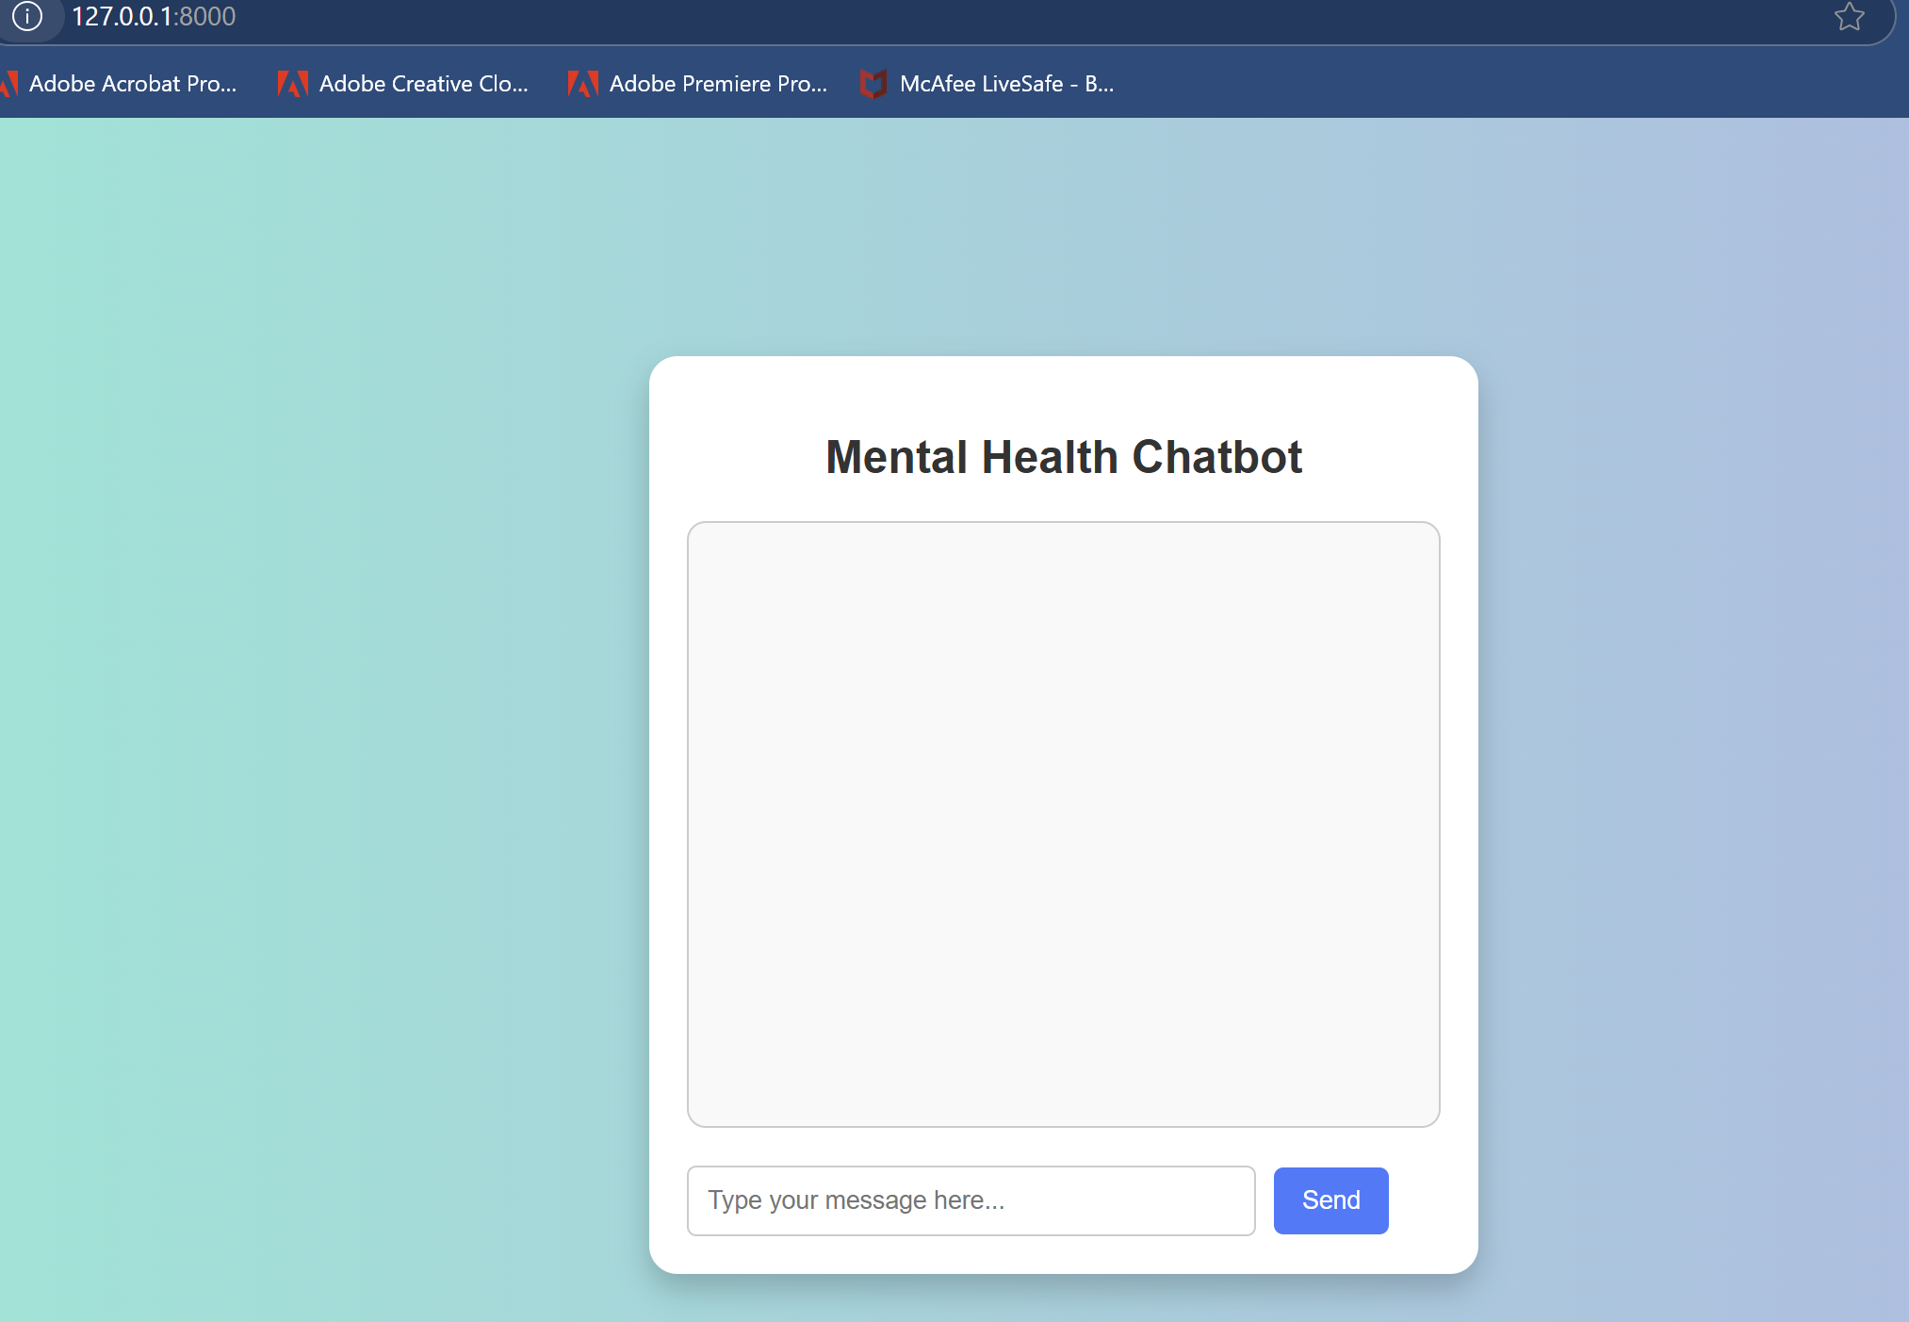
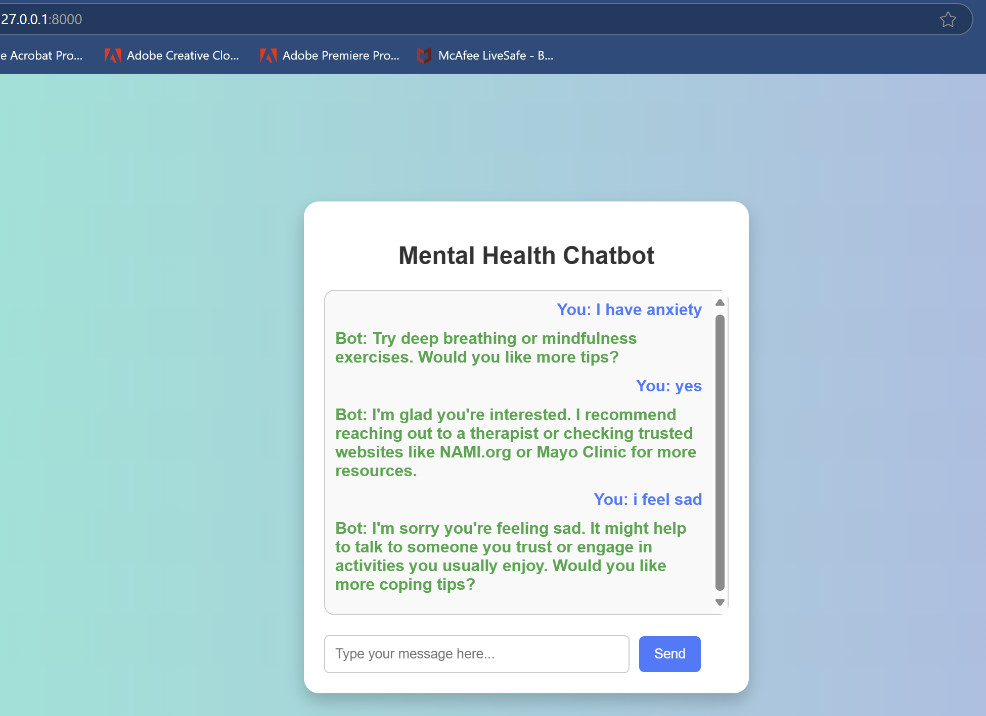
Mental Health & Medication Education Chatbot
"Providing supportive mental health tips and trusted medication education through a simple AI chatbot."
https://github.com/ksu-hmi/AI-Chatbot-for-Mental-Health-Support-and-Medication-Education
Blanche Payton

