Slide 1

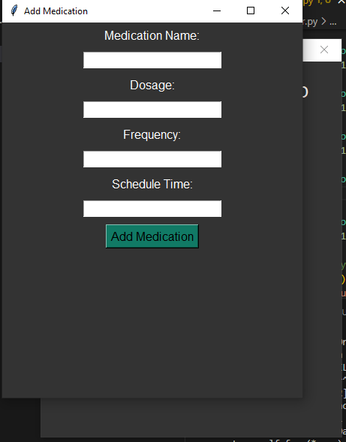
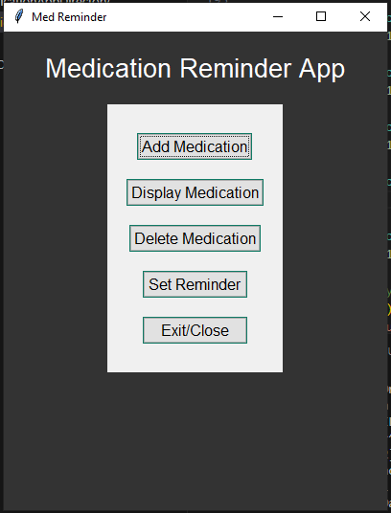
DoseMate: Smart Reminders for a Healthier You
Developers: Anita Ajuebor, Briana Willams, and Zainab Suara
"DoseMate: Where Wellness Meets Reminders, Every Dose Counts."

