Slide 1
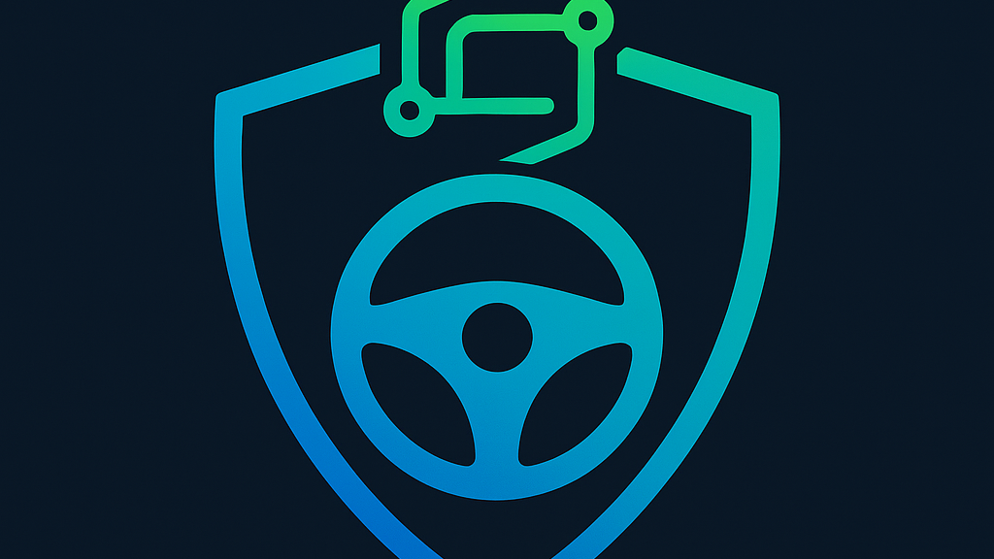
DriveGuard360
A driver monitoring system that detects drowsiness, stroke symptoms, and medical emergencies while driving.
“Safety That Never Sleeps”
By: Purity Varist, RN, BSN

