Slide 1
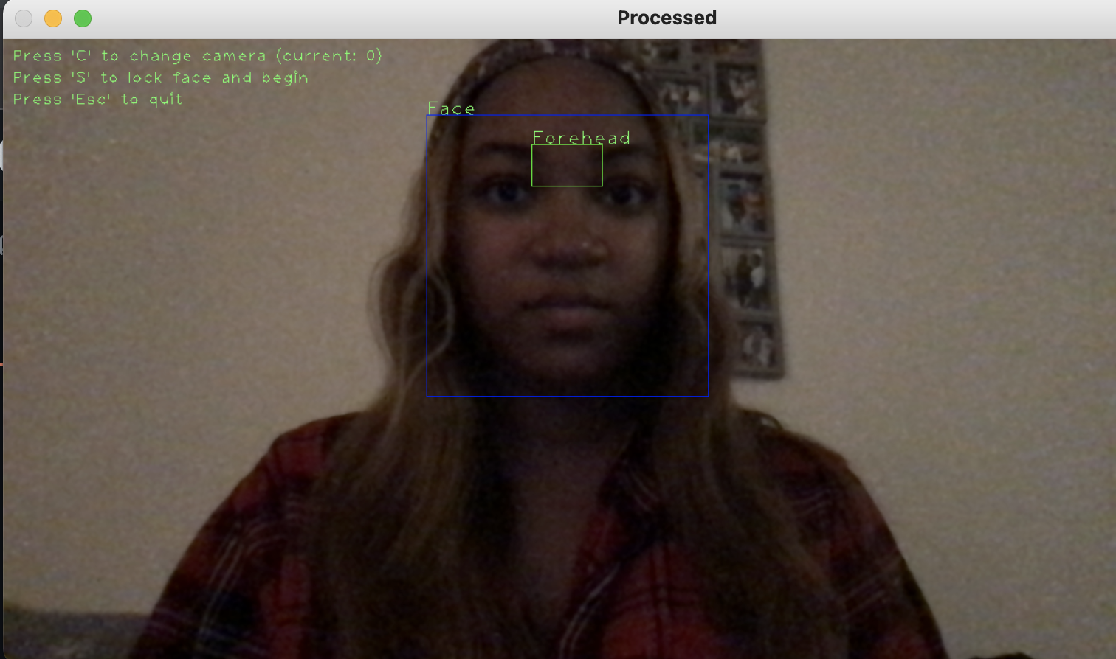
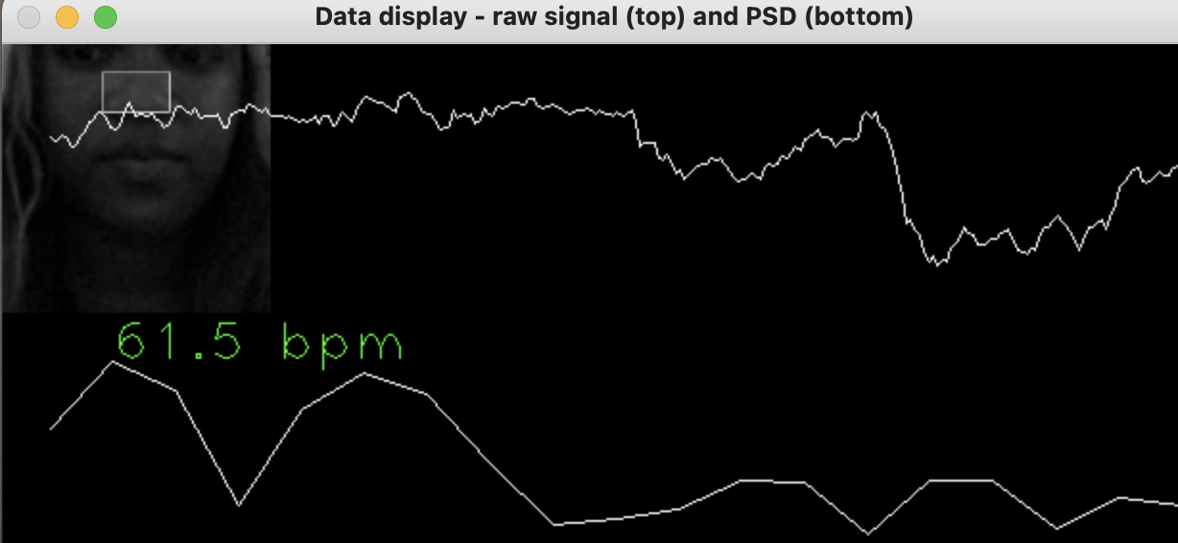
Heart Rate Monitor
Monitor your heart rate from the comfort of
your laptop using your webcam
Jada Jackson
Janna Pruiett

