Slide 1

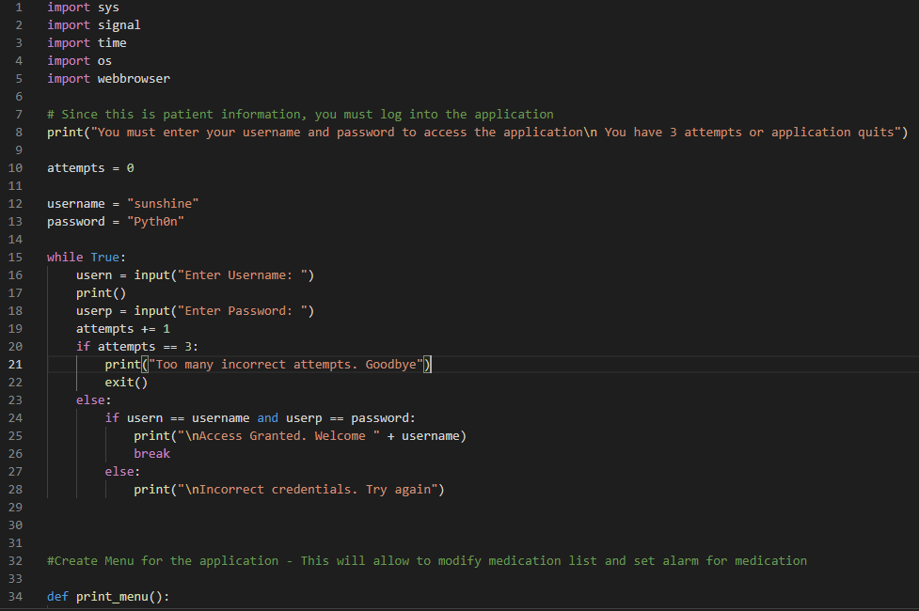
It’s Time!
A Medication Reminder
Creaters:
Ronda Broome
Melissa Hudson
Code Attributions:
(insert here)
Features:
Password Sensitive
Add Medication
Delete Medication
Review Medication List
Alarm Feature
Exit
A Wakanda/Zumunda©
collaboration

