Slide 1

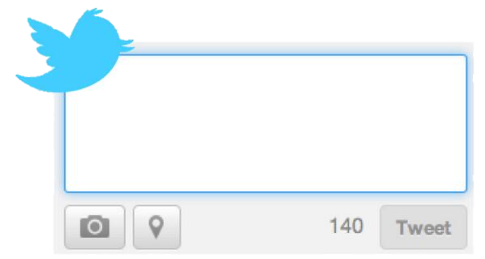
VIAA Newsbot
VIAA will populate a media feed based on user entered keywords. Users will be able to select which news options to post to their social media accounts such as Twitter.
#newsbot #finalproject #python
Coded by Tae Jones and Tasha Cabrera
https://github.com/ksu-hmi/VIAA-News-Bot

