Slide 1
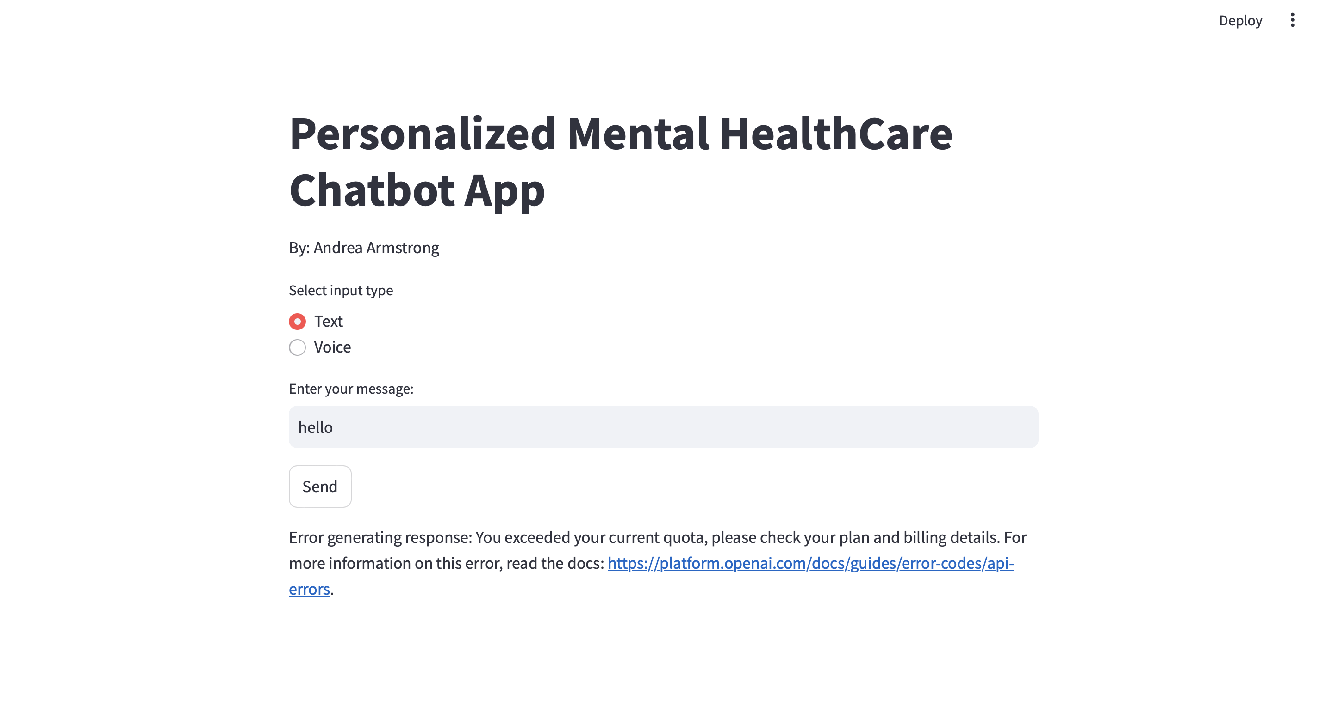
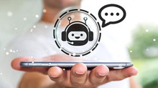
Personalized Mental Health Chatbot App
"Your Personal Mental Health Ally – Always Here, Always Listening."
Team members: Andrea Armstrong
Key Features:
AI-powered chatbot offering personalized mental healthcare support.
Provides evidence-based advice for managing mental health.
Delivers automated assistance to address mental health needs.
Empowers users to take control of their mental wellbeing.
https://github.com/ksu-hmi/Personalized_Mental_Healthcare-Chatbot

