Slide 1
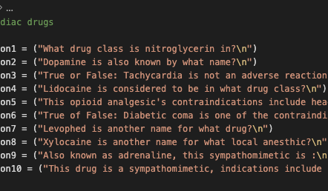



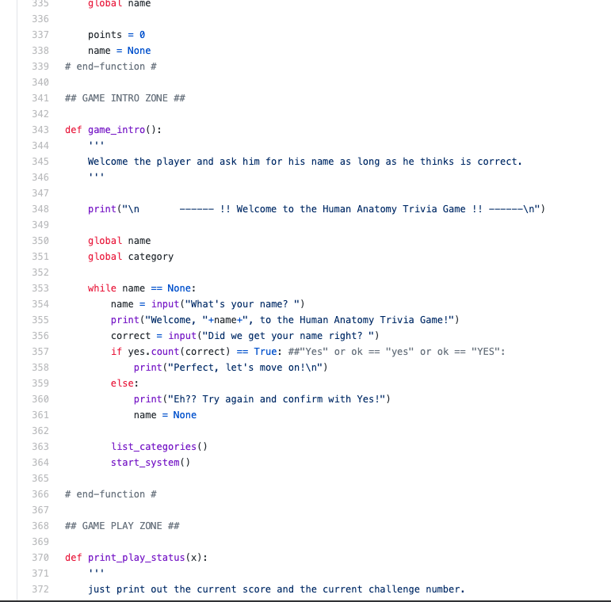
Pharmacology 101!
Akasha Lawrence
Kennedy Craig
A text-based trivia style game designed to help nursing students, medical professionals, and even patients learn the ins and outs of drugs/medications
This Photo by Unknown author is licensed under CC BY.
This Photo by Unknown author is licensed under CC BY-ND.

