Slide 1
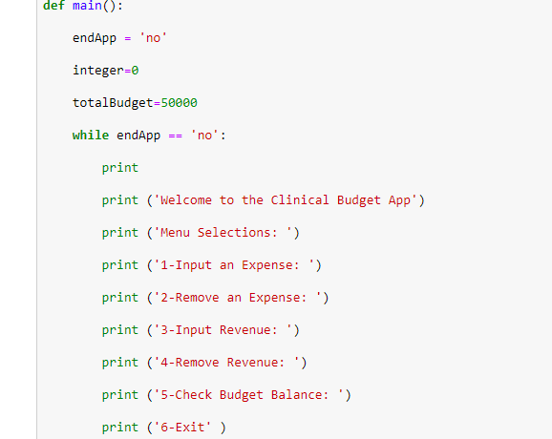
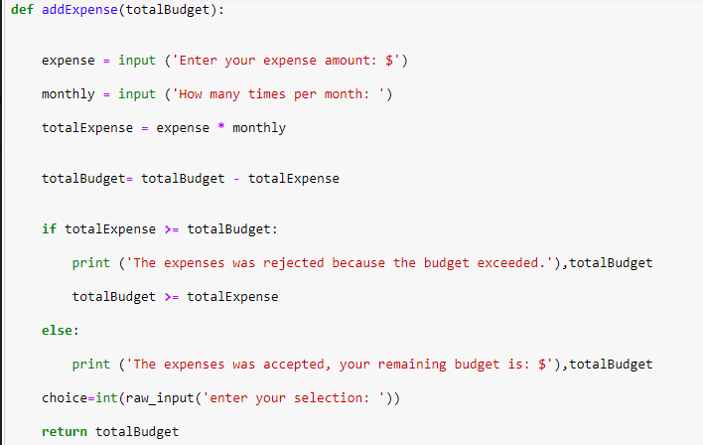
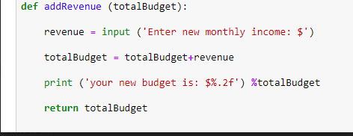
Clinical Budget Application
Our application will redefine how hospitals and physician offices designate and divide their spending cost and budget
Uchenna Mogbo, Robert Oru, LaMeeya Bumphus, Athena Walker

