Slide 1

Sickle Cell Detection through Imaging
A tool for medical practitioners to diagnose Sickel Cell Disease early (SCD).

Slide 2



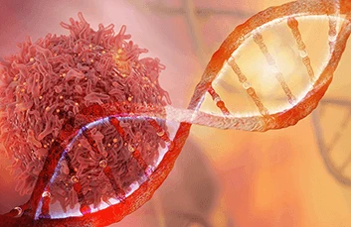
Our Team for Pysickle Cell
A tool for medical practitioners to diagnose Sickle Cell Disease (SCD)
early.
Brandii Baugh
Poornima Shahitha Katragadda
Coder
Coder
The original coder is: EHLeRoux from https://github.com/EHLeRoux/SickelCellDisease
Our code: https://github.com/ksu-hmi/PySickleCell

Slide 3
AGENDA
Introduction​
Primary goals
Our Project
​Areas of growth in the software
​Summary​

Slide 4
Introduction
What is Sickle Cell Anemia? Who is affected? What are the sign and symptoms?
Sickle cell anemia is one of a group of inherited disorders known as sickle cell disease.
This disease is commonly linked to African American community.
It affects the shape (sickled) of red blood cells, which carry oxygen to all parts of the body. Red blood cells are usually round and flexible, so they move easily through blood vessels.
In sickle cell anemia, some red blood cells are shaped like sickles or crescent moons.
Signs and Symptoms : episodes of pain, swelling of hands and feet, frequent infections, delayed growth or puberty, and vision problems.

Slide 5
PRIMARY GOALS
To find the mutation of sickle cell by images of blood cells.

Slide 6
PySickleCell Software
The development of this program would assist patients and their families with early detection of acute physiological deterioration leading to organ failure is not always manageable for individuals with Sickle Cell Disease (SCD).
This software would detect the mutated DNA sequence which helps in the identification of sickle cells.
This system would firstly use machine learning techniques that allow for prediction of organ failure from physio markers may enable earlier identification, treatment, and potentially reduce mortality. The software would secondly, have the capability to predict the patients’ signs and symptoms of organ failure over a period for a treatment plan to decline mortality rate for SCD.

Slide 7
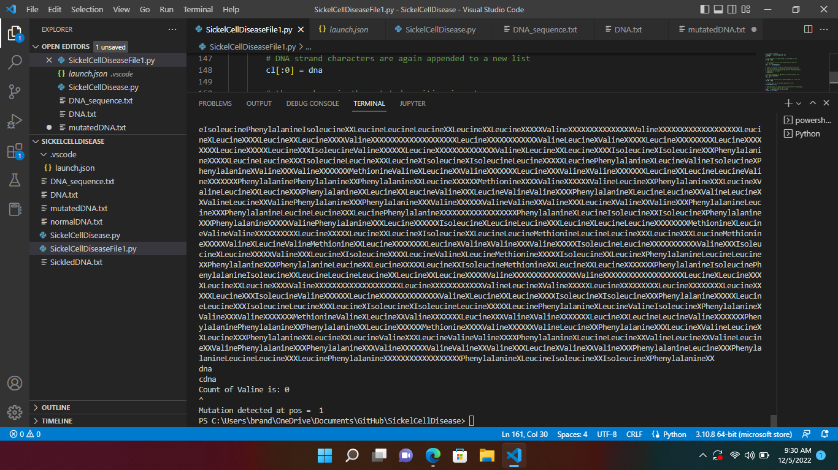

Slide 8
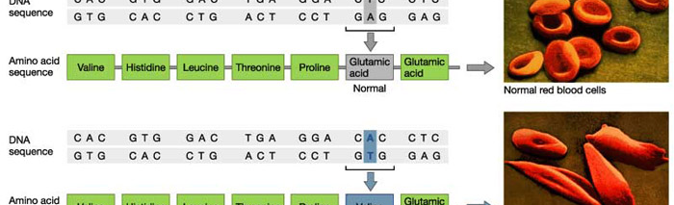
Normal and Mutated DNA
We were able to add in a different ways to sequence DNA using letters of the alphabet. Individuals that have sickle cell have a different DNA sequence compared to those without. A normal DNA sequence goes as shown above CTC and GAG with the Amino Acid being glutamic acid in the 6 codon. In individuals with Sickle Cell the 6th the sequence is swap from A to T making the Amino Acid Valine.

Slide 9
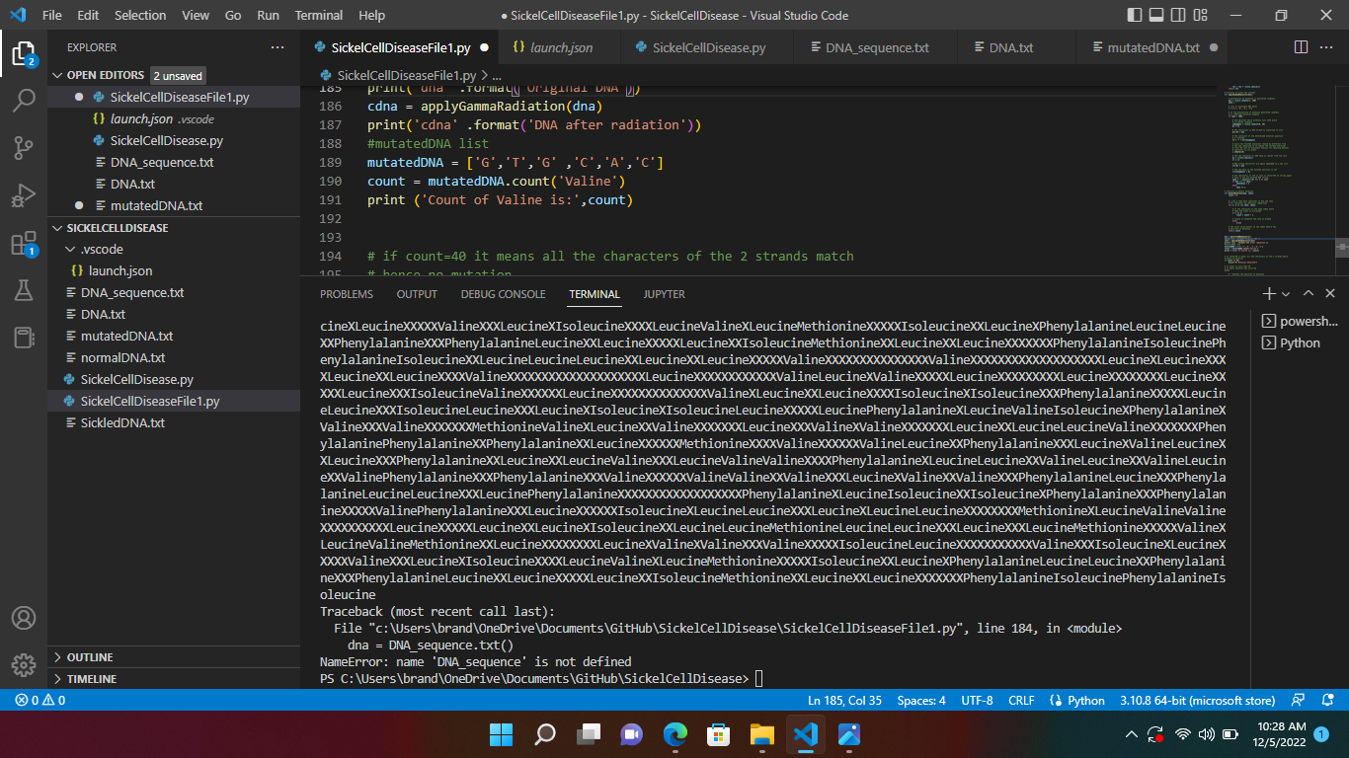
Changes Made

Slide 10
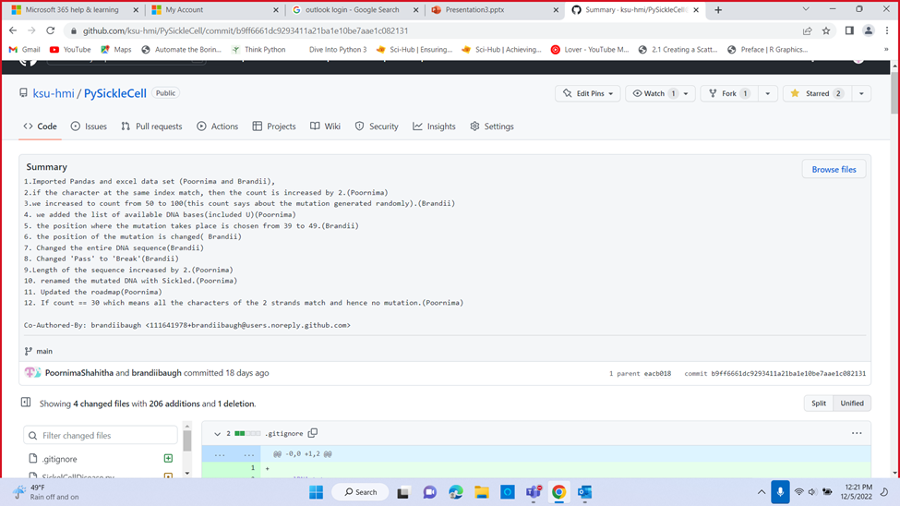

Slide 11

SUMMARY
We were able to make a change and add more into the program to make it better such as adding count to show which of the following Amino Acids could be the mutated DNA. We were able to add in images to have them identified
This Photo by Unknown author is licensed under CC BY-ND.

Slide 12
THANK YOU
Brandii Baugh
Bbaugh6@students.kennesaw.edu
Poornima Shahitha Katragadda
Pkatraga@students.kennesaw.edu

