Slide 1
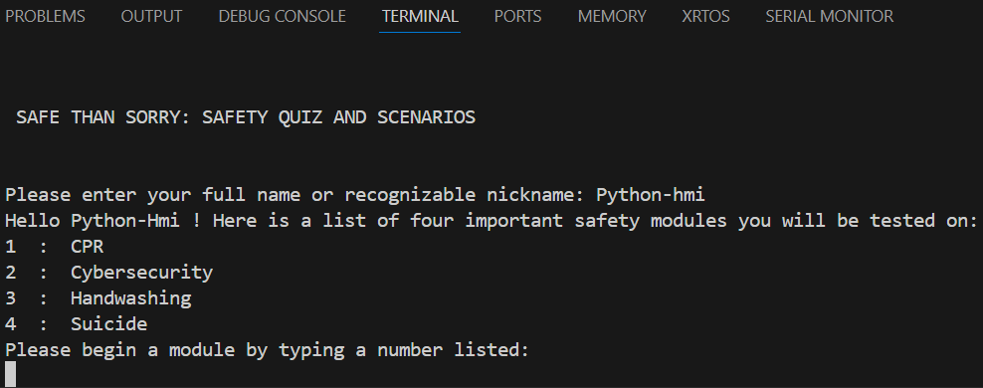
SAFE THAN SORRY: QUIZ AND SCENARIOS
Its better to be safe than sorry.
Quiz now to test your safety knowledge!
4 TOPICS, 40 QUESTIONS
By: Jasmine Cooper
Original: Rachel Sykes

