Slide 1

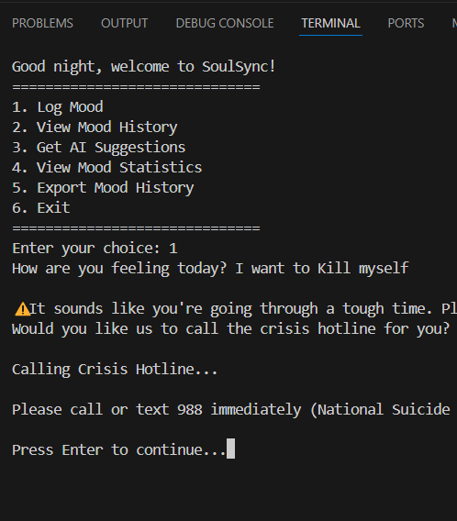
SoulSync
Empowering emotional wellness through mood tracking, AI-driven suggestions, and immediate crisis support — anytime, anywhere.
Coder: Mark A. Jefferson
Orignial code: https://github.com/MarkJefferson/SoulSync

