Slide 1
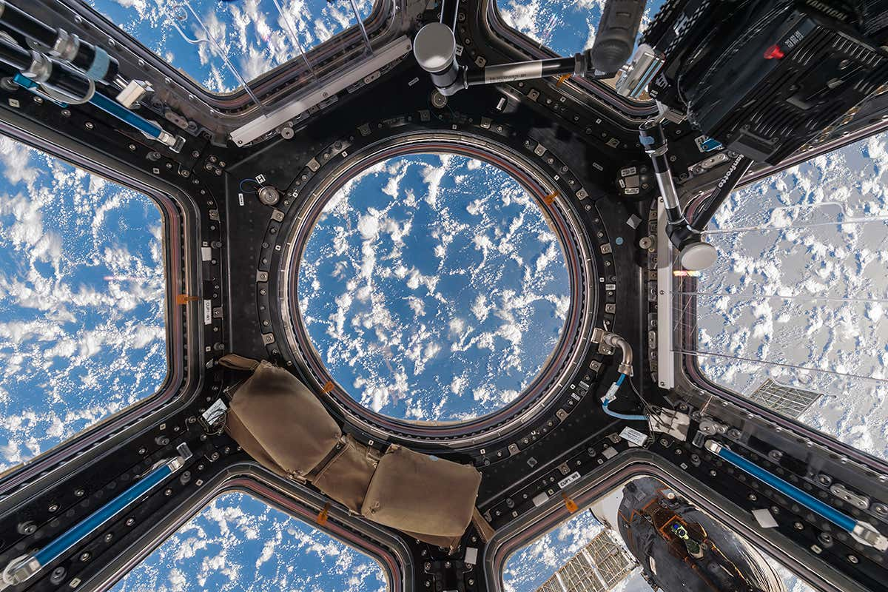
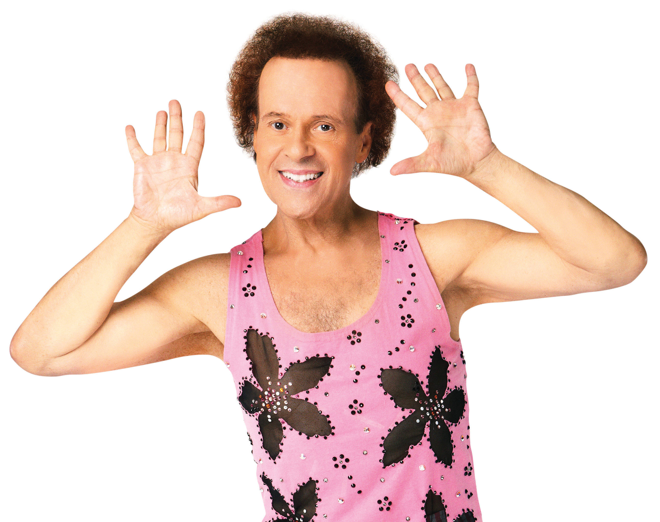









Where in the World is Richard Simmons?
Probably on the International Space Station...
And Here’s Where to Find Him!
/Using code to track the ISS/
Code by: Brandon Kenemer

