Slide 1


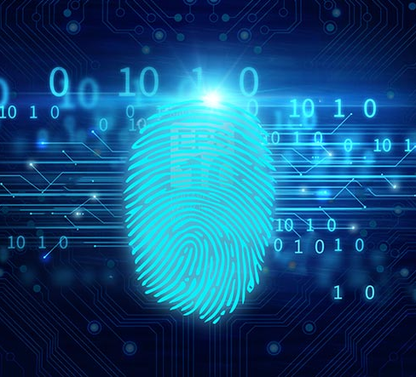
Staff-Checker A biometrics platform to checkmate irregularities of derelict workers
By: Emmanuel Adeyemi
Based on a tutorial made by:
Przemysław Pastuszka

