Slide 1
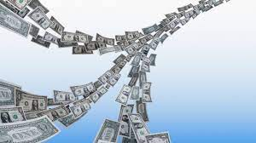
The ValuChain
…a billion-dollar annual stream of income.

Slide 2
The market…
Think about the billions in USD spent by Pharma companies in advertorials which sometimes do not get to the desired key opinion leaders
Think about the enormous resources being wasted for not seeing the right provider for the right medical condition
Target? Yes! Pharmaceutical companies and millions who seek professional healthcare services.

Slide 3
Meet the ValuChain…
A GIS-enabled monthly update of HCPs list in different therapeutic areas of medicine to help pharma companies in HCPs engagement and feedback monitoring on therapies.
To help individuals seek the right medical information/consultations without ambiguity (the right information from the right doctor)

Slide 4
Let’s build, let’s reap!
ValuChain is not a medApp, but a complete money-spinning machine
Thank you!

