Slide 1

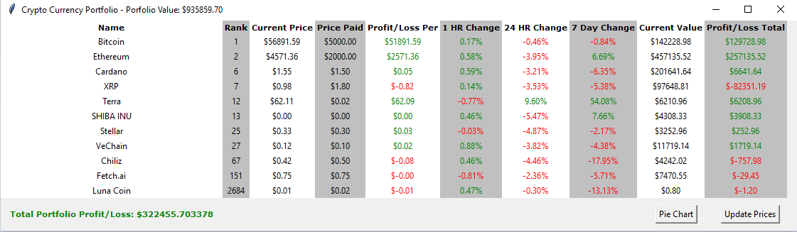
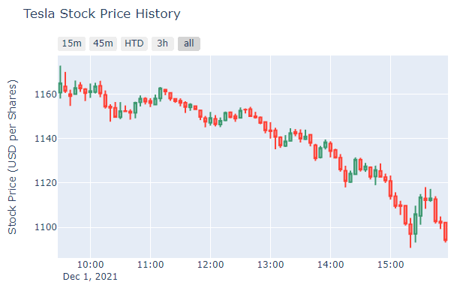
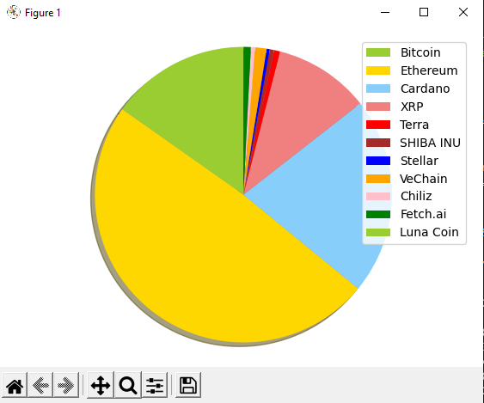
Crypto and Stock Market Portfolio Display Apps
Allow users to build custom crypto/stock portfolios and display real time price updates!
Created by:
Yesake Abaye
Eric Gaare
Mumbi Kairu
Erna Mercier
Usen Usen
https://github.com/ksu-hmi/cryptostockportfolio

