Slide 1

SmartChoice Recipes An app that generates healthy recipe options based on dietary restrictions
Coder: Jordyn Fleming
https://github.com/ksu-hmi/pythonproject

Slide 2
What Is the Big Idea?
The core idea is to develop an application that allows users to input their dietary restrictions (such as gluten-free, vegan, low-carb, nut-free, etc.) and preferences.
Based on the inputs, the app will search and present a list of recipes that meet these criteria.

Slide 3
What was Used?
The link below is a beginner friendly Python tutorial I used to help with SmartChoice Recipes generator using Tkinter and Edamam API
https://www.youtube.com/watch?v=bmt1x_Mjg-s
A source/code is below that helped guide me through this project https://github.com/itohan-uk/MySWEspace/blob/master/recipeApp/recipeApp.py

Slide 4
Project Development
Roadblocks:
Difficult to find sources/codes that aligned with my project idea
Installing packages (pillow, py-edamam, requests)
Changes Made:
Removed playsound from original code source
Additional search options for dietary restrictions

Slide 5
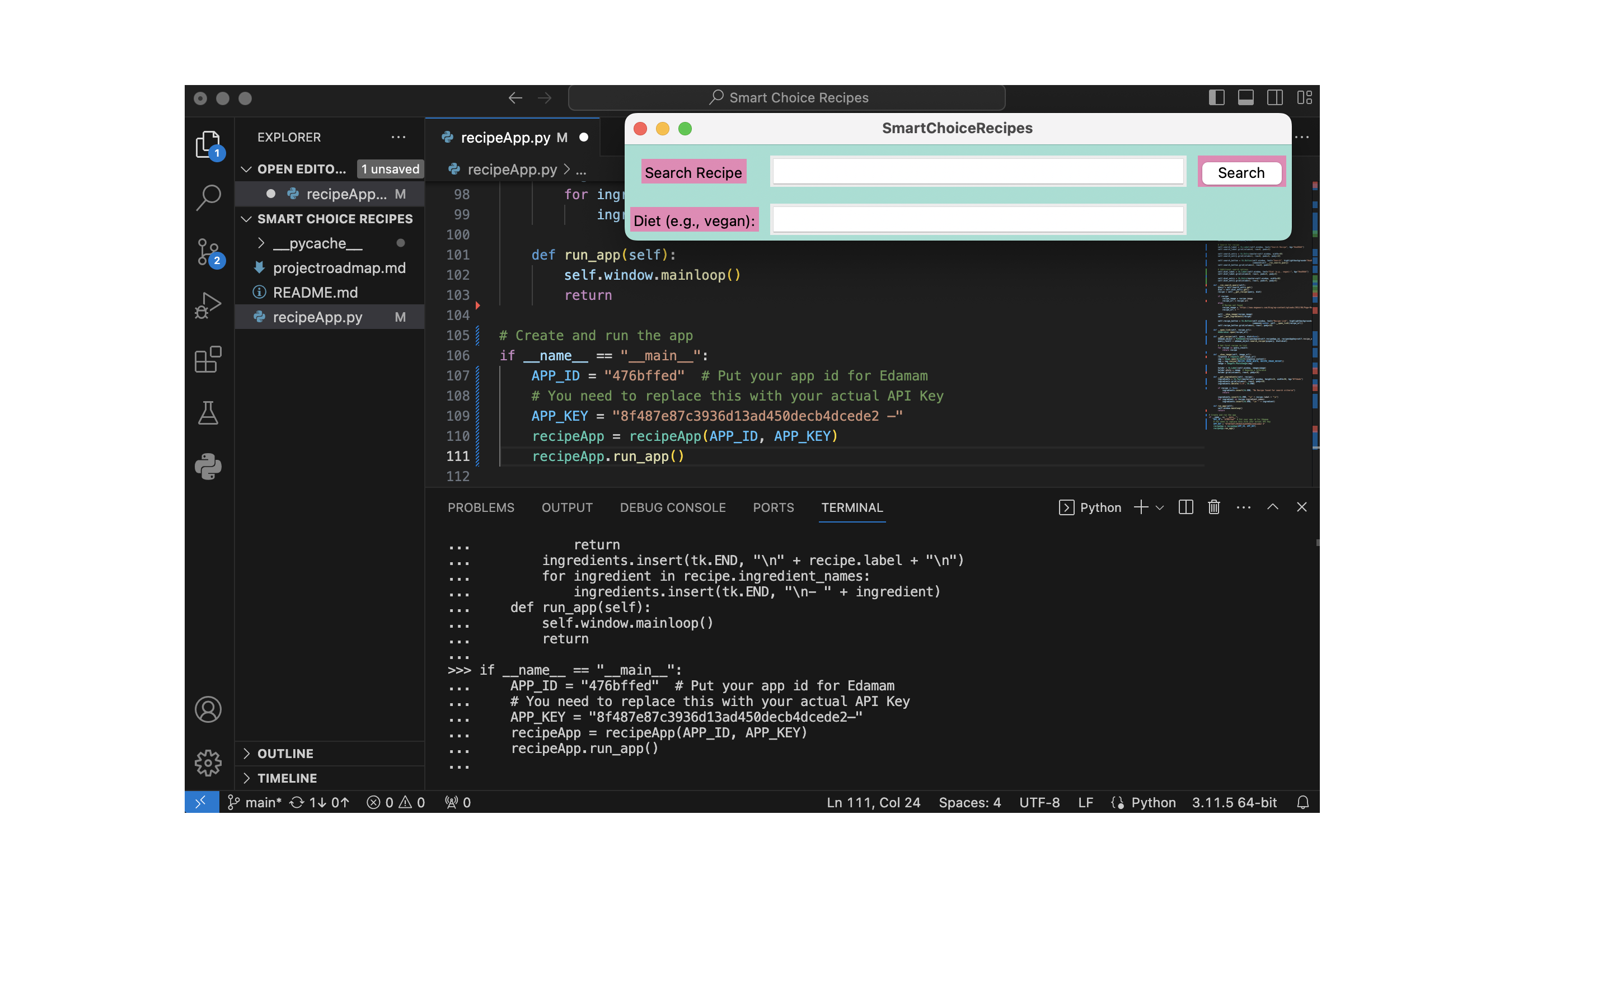

Slide 6
Next Steps
Advanced Search Options:
Including additional search filters like meal type (breakfast, lunch, and dinner)
Allow users to exclude certain ingredients from their search
Shopping List Generator
Add a feature to generate a shopping list
Health and Nutritional Information:
Provide additional health and nutritional information, possibly linking ingredients to health benefits or risks

Slide 7

Thank you!

