Slide 1

Contemporary Photo Album

Slide 2

This photo album contains sample pages to get you started.
To add your own pages, click the Home tab, and then click New Slide.

Slide 3



Choose a layout…
…then click the placeholders to add your own pictures and captions.

Slide 4
Click a picture, and then click the Format Picture tab to create your own frames and make picture corrections such as adjusting contrast and brightness or cropping the picture for just the right look.

Slide 5
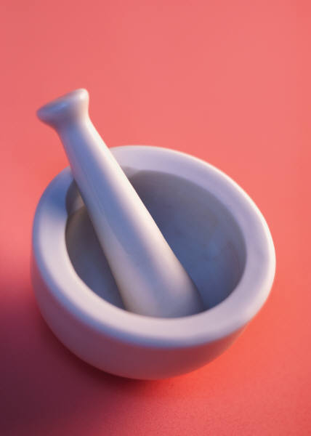

Picture Styles give you great looking “frames” in a single click.

Slide 6




