Slide 1
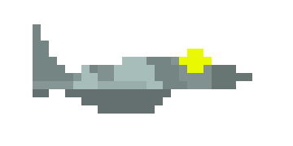
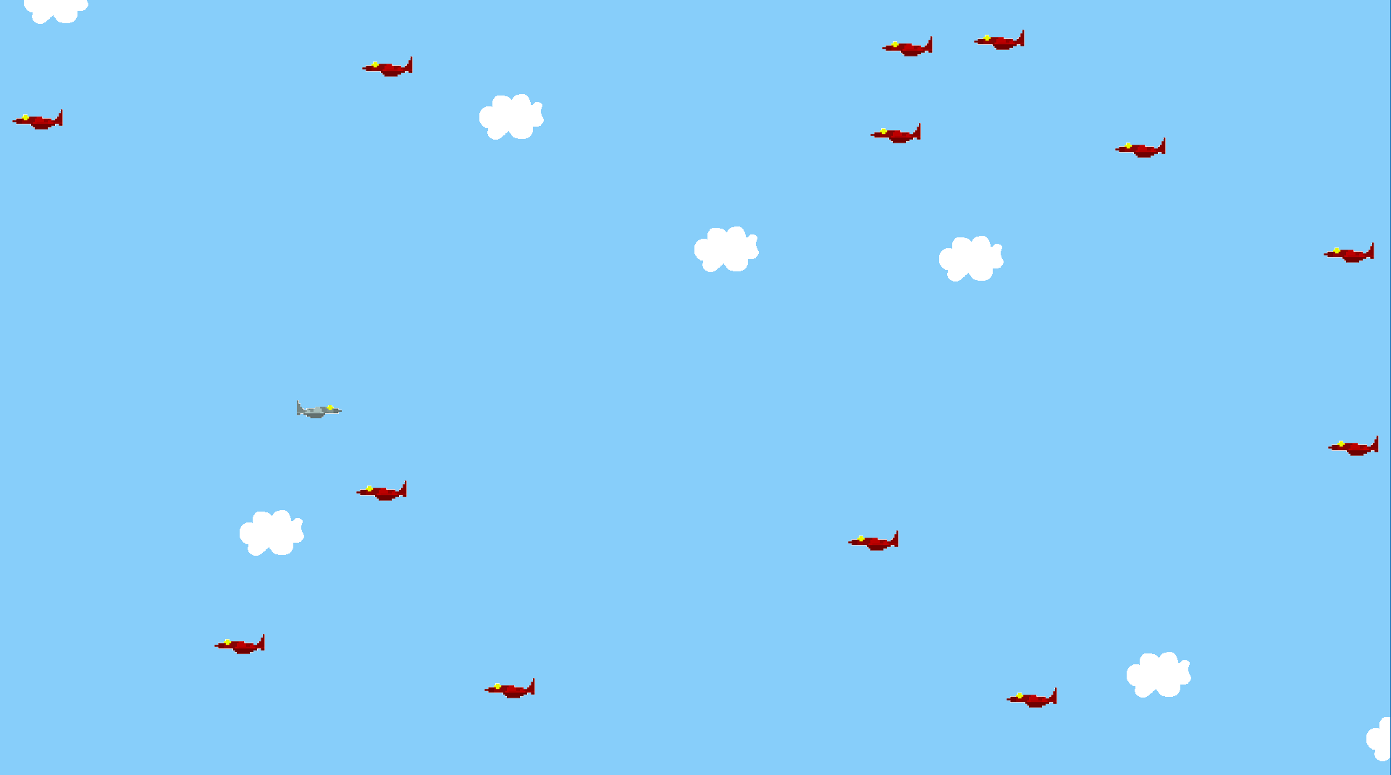
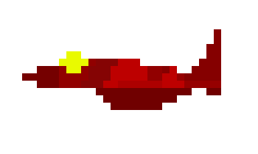
Jet Fighter
Shoot down enemy aircraft in a 2D side scrolling action game!
Made By: Aaron Nicolette

