Slide 1
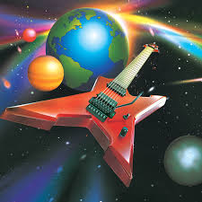
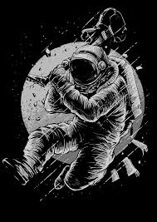

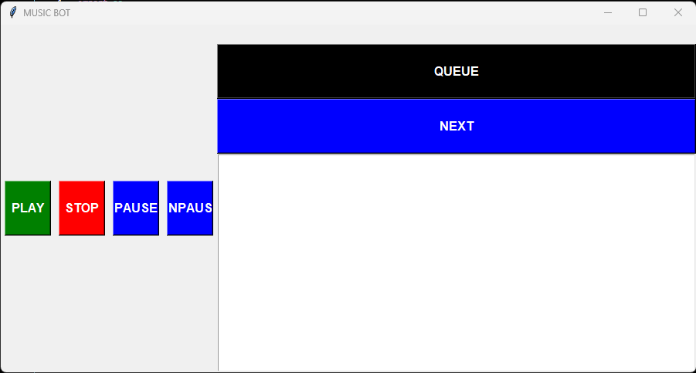
Music Bot by Xavier Jones
The one thing you’ve been missing in your parties.
This Music Bot allows you to play any music at anytime for friends, family, or just you.
You add the music of your likings and then let the party begin
Github Link

