Slide 1
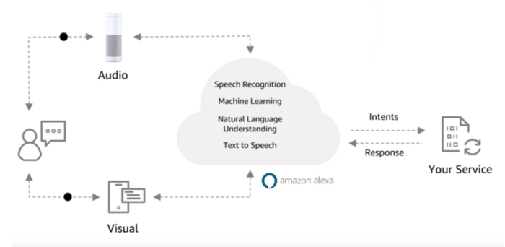

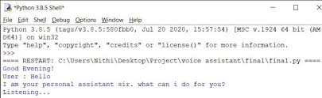
AI – Task Keep Control of Time!!! Voice Activated Assistance (Friday) helps you manage your time with your tasks of everyday life.
DEVELOPER: MAIR KEEN
ORIGINAL DEVELOPER: M. MIRTHULA

