Slide 1

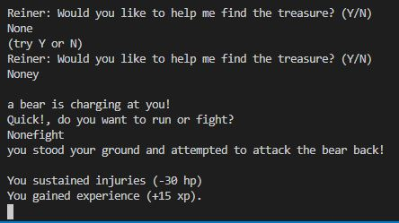
Adventure Game
Developers: Adam Hawkins and Braxton Jemison
A simple text-based adventure game.

