Slide 1
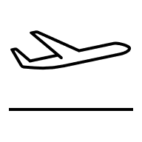
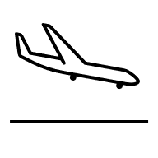
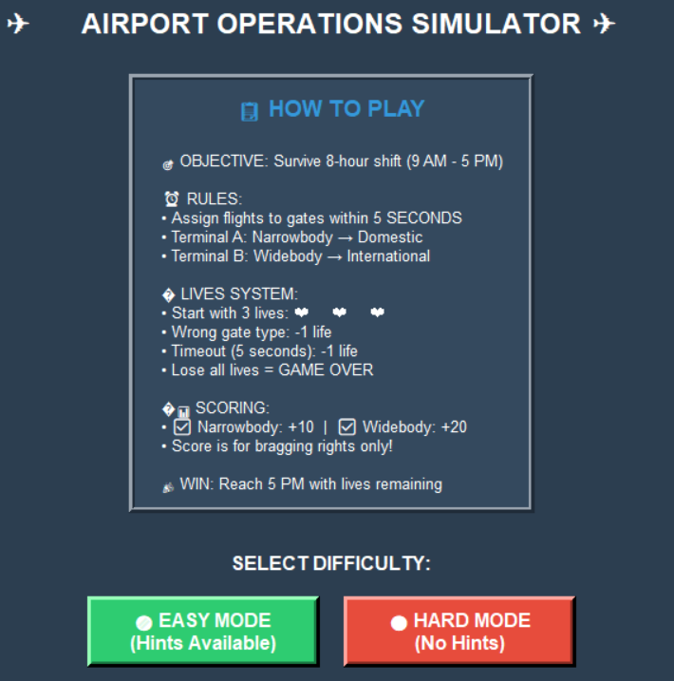
Airport Operations Game
M a n a g e t h e M a d n e s s .
M a s t e r t h e G a t e s .
B e a t t h e C l o C k .
Race against a 5-second countdown to assign incoming flights to the correct terminal gates in this fast-paced airport dispatcher challenge.
Designed by Rowan Seskin and Gabrielle Godfrey

