Slide 1
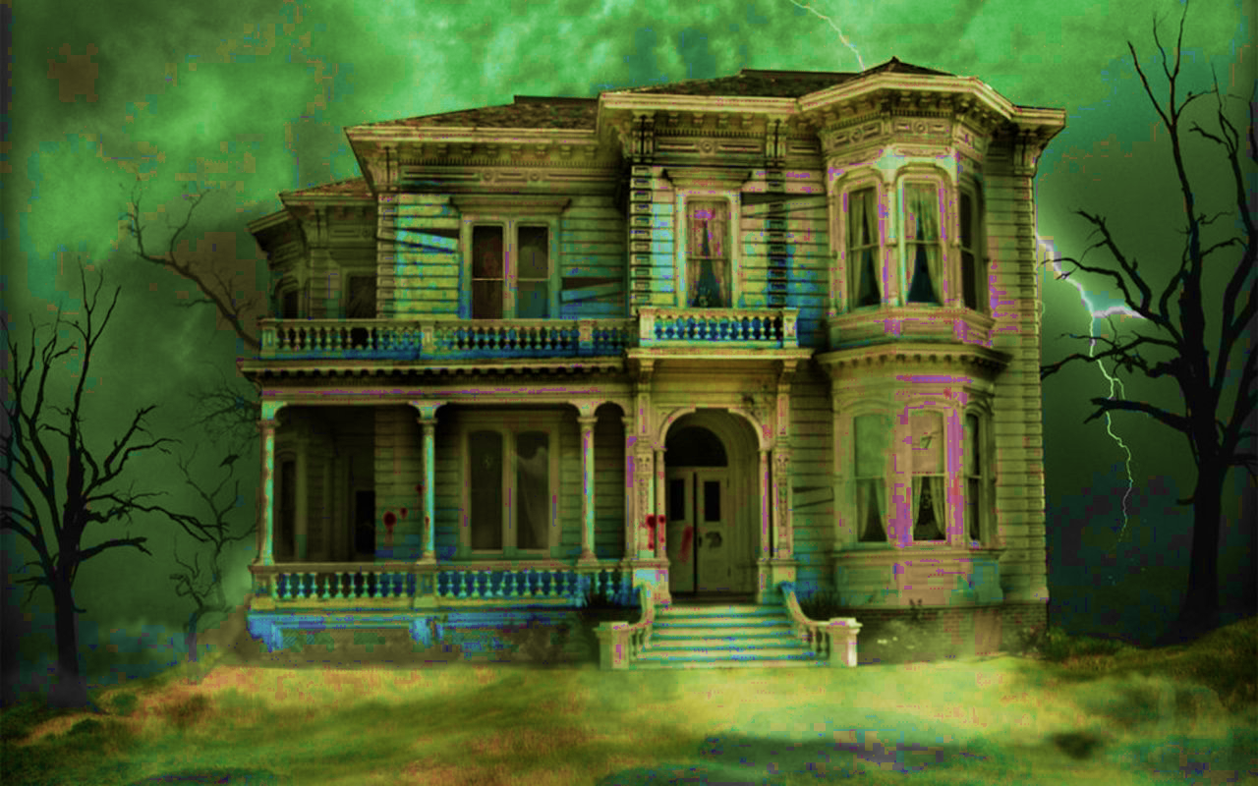
An Unfortunate Fright Night
…choose your scary story…
Coding by: Shannon Jones and Sydney Elledge
With attributions by: HisRoyalFreshness and Robert Jomar Malate

