Slide 1
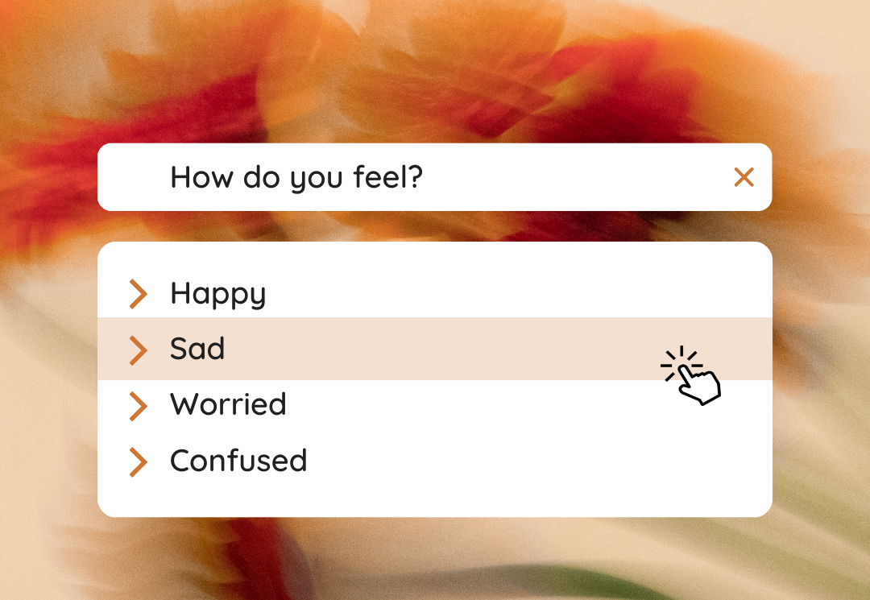
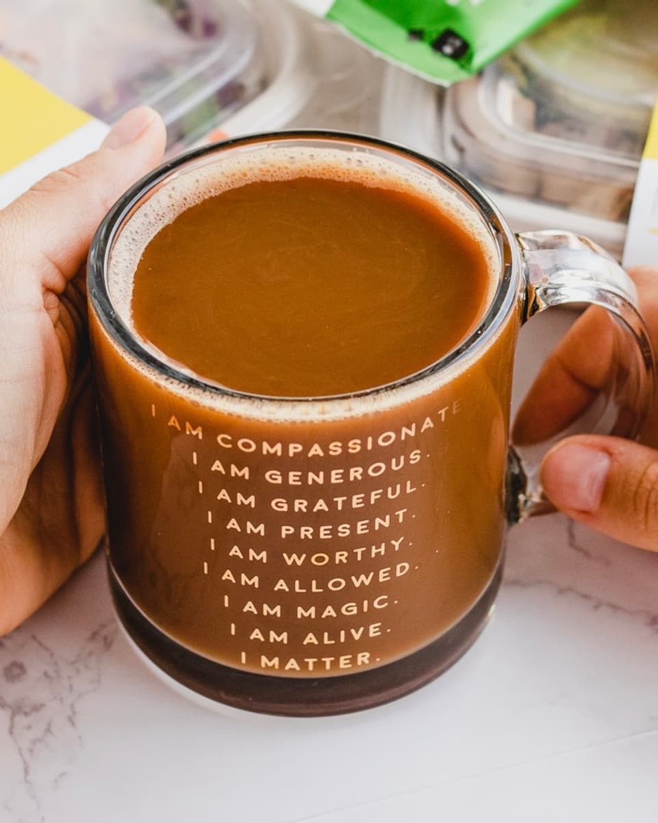
Ask-ir-mations
These days we are constantly on the move and that can cause us to quickly lose our sense of self and our peace of mind. This software will ask users to select an adjective of how they feel and then the system will give them a positive affirmation that relates to their current mood. Ask-ir-mations is here no matter the time, place, or occasion with just the right words to ease your mind.
Team Members: Ebony Laudat

Slide 2
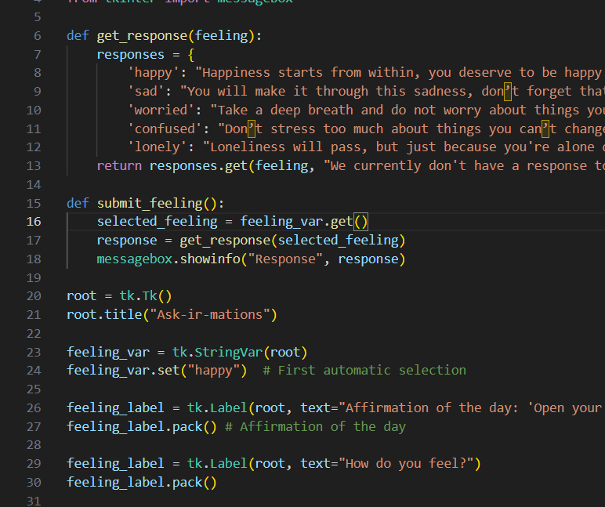
How it’s Made
The app was coded in Visual Studio Code using the Python Language and Tkinter interface.
Inspiration from An-AI-Chatbot-in-Python-and-Flask: https://github.com/mainadennis/An-AI-Chatbot-in-Python-and-Flask
Tkinter-GUI: https://github.com/Yrajaram112/Tkinter-GUI/blob/master/Dropdown%20menu.py
YouTube Video: https://www.youtube.com/watch?v=eoy9_S0sfP4

Slide 3
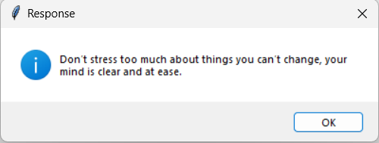
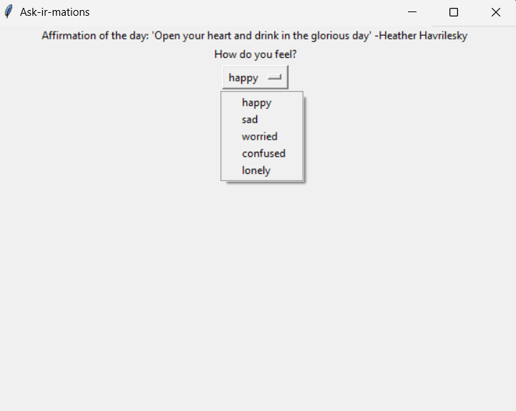
Our App
When first opening the program users are presented with the affirmation on the day at the top of the page. The drop-down menu is where you can select what emotion you are currently experiencing. After selecting the emotion and submitting it, a positive affirmation will then pop up on the screen which is related to the emotion the user selected.
Link to my GitHub Repository: https://github.com/ksu-is/Ask-ir-mations

Slide 4
say goodbye to negativity and hello to the positive power of Ask-ir-mations.

