Slide 1
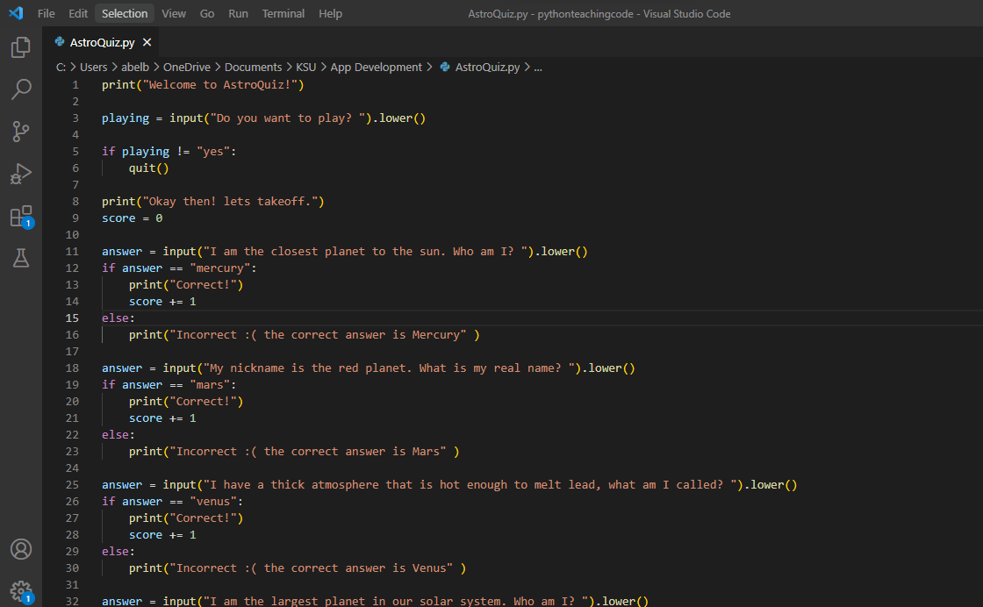
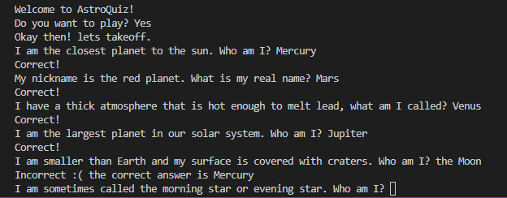
AstroQuiz
Created by Abel Bahru
AstroQuiz is an interactive and educational astronomy quiz guessing game geared towards new students that expands knowledge about our solar system and keeps score.

