Slide 1



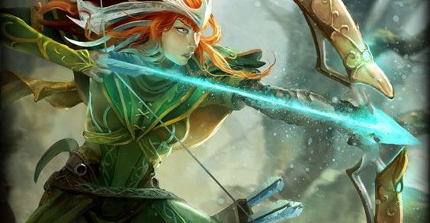
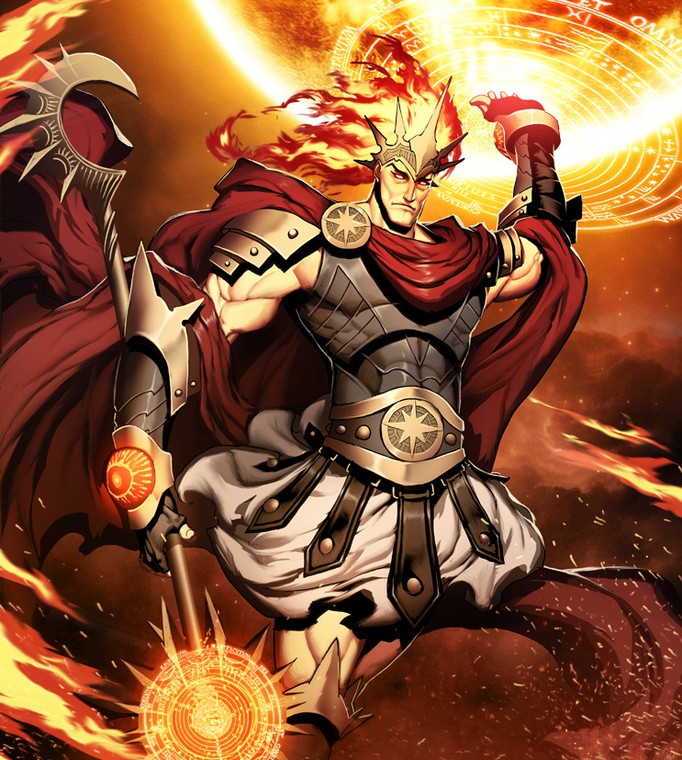

Battle of the Gods A turn-based attack game in the code terminal.
By Eric Mata
https://github.com/ksu-is/Battle-of-The-Gods-

