Slide 1
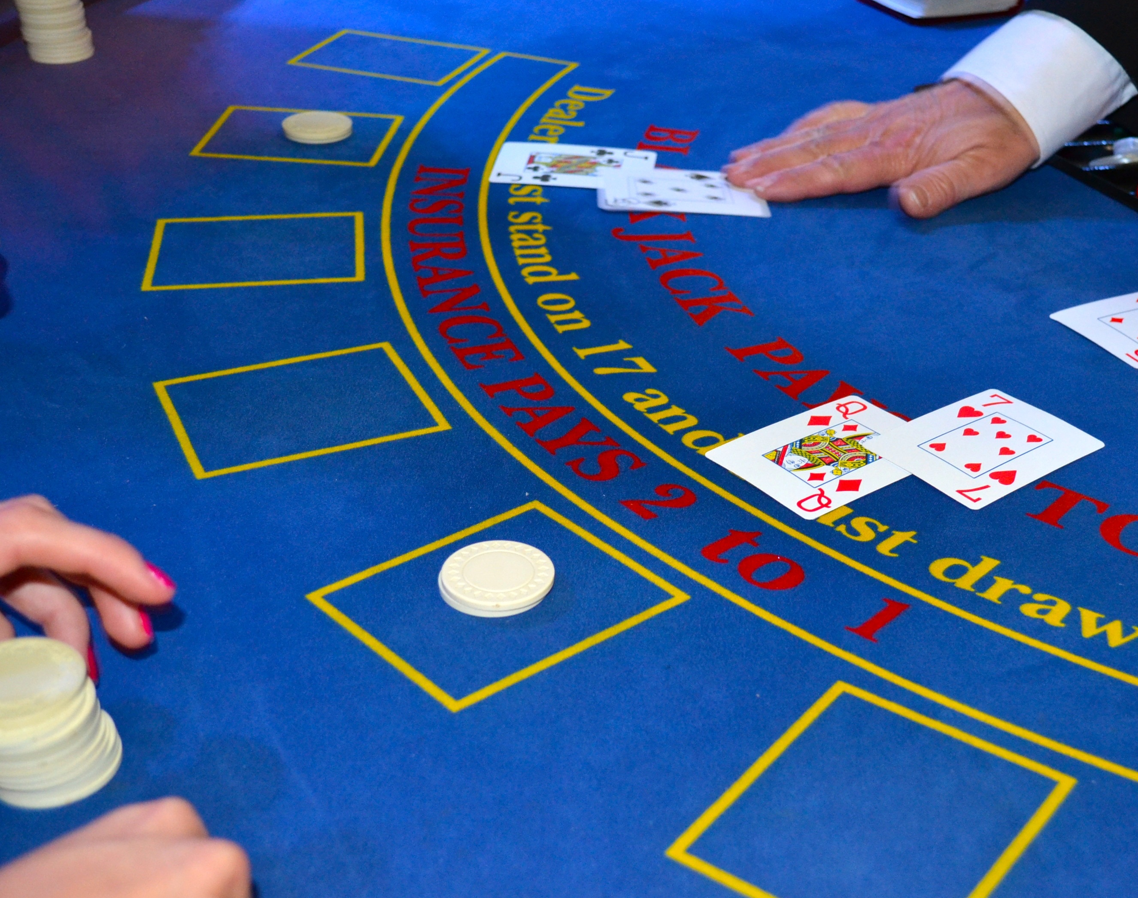
Black Jack Simulator
By Felix Botero & Jake Henley, IS3020
Honing your blackjack skills one game at a time!

Slide 2
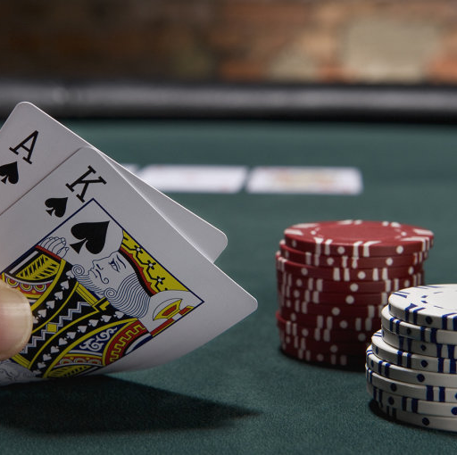
Introduction to our simulator.
Why did we go with this idea?
tutorials/ repos we used for inspiration
Link to our Repository https://github.com/ksu-is/Black-Jack-Simulator
ThePhoto by PhotoAuthor is licensed under CCYYSA.
Notes:
We decided to use this idea because we have a bachelor trip at a casino coming up and thought it would be the perfect opportunity to create a simulator to practice and hone our blackjack skills. It also seemed to be a great idea to create something fun that we enjoy doing on our freetime. We used a repo on github by someone named pascal, it was a simple game which gave us a starting point gor the game logic.

Slide 3
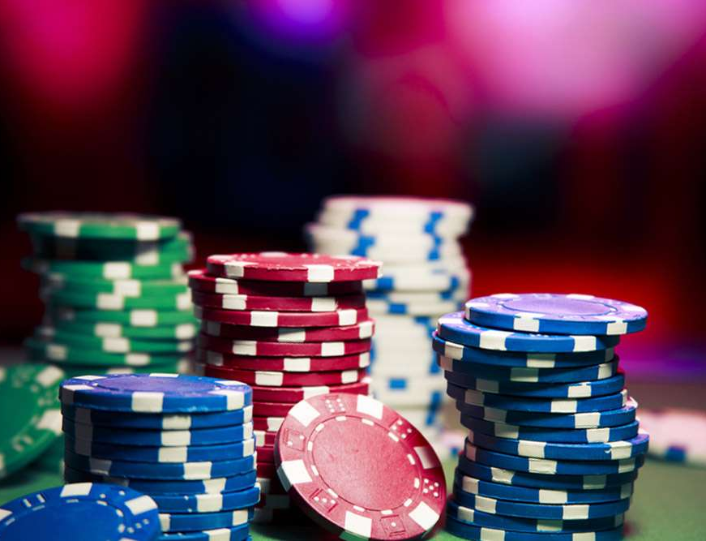
Roadblocks & Development
Roadblocks faced
Game was too bland
Had a hard time making the aces count as both 1 and 11
Major updates made
We added a GUI
We added a dealer card count tracker
Notes:
Originally, the app ran only in the terminal, which led to us feeling as if the game was too bland and ultimately leaving us discouraging. We also struggled with the ability to count aces as both 1's or 11's at first, but we were able to overcome that.
We updated the app by utilizing tinker to give it a GUI and make it feel at little bit better, I still would've liked to have made the app seem more realistic but my skill and knowledge in coding only goes so far at this point.
We also added a function to display the dealer card total since it didn’t do so at first on the GUI ultimately causing us to have to count the dealer cards after defeat, which was mostly my OCD speaking!
Another thing that we had to do was import game assets, and what we ended up choosing was this game asset website called Kenney. What they offer is free 2D and 3D game assets. So what we did was import cards to just give our simulator an overall better look and it was relatively easy. Just had to create a new file within our repository that would hold the cards and move the png's over. We also had to mat

