Slide 1
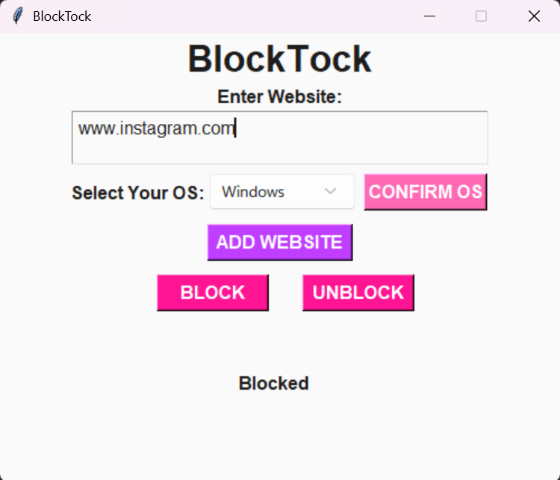

Turn Back the Clock with BlockTock!
Izzy Clarke & Josefina Saavedra
In today's world, social media is deeply embedded in our daily lives, often leading to poor time management and constant distractions. This project introduces a Python-based productivity app that lets users enable or disable access to selected websites. It's an effective tool to stay focused on school or work, reduce screen time, and reclaim lost hours. Take back control of your time today!
BLOCKTOCK GitHub Repo

Slide 2
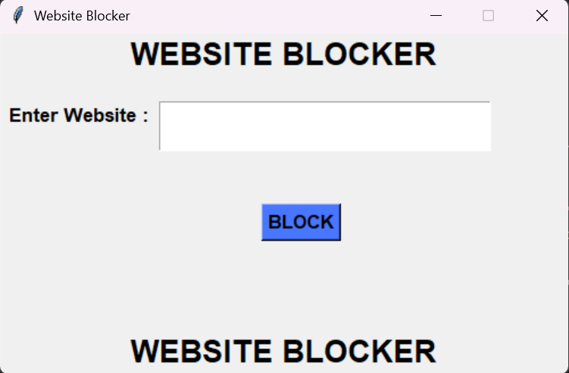

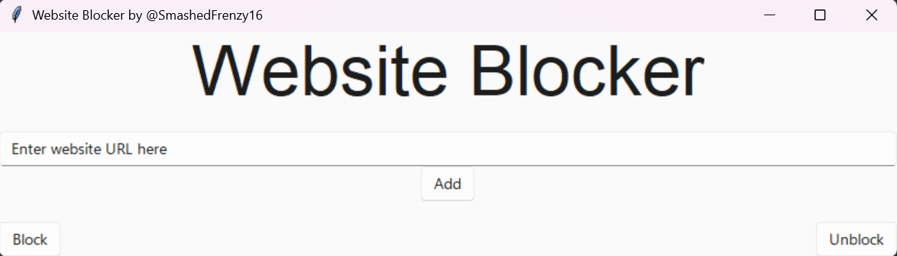
Resources
2
★ ExistingCode1:
https://github.com/AzharAnwar9/Python-Website-Blocker/tree/main
★ ExistingCode2:
https://github.com/Yash-2403/Python-Website-Blocker
★ ExistingCode3:
https://github.com/SmashedFrenzy16/Website-Blocker
3

Slide 3
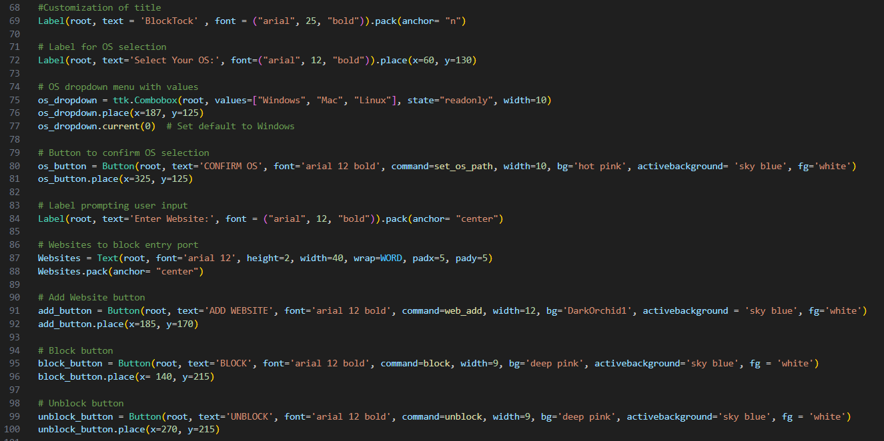
Actual Code

Slide 4
Roadblocks
★ Figuring out how to build code as a beginner.
★ Finding portions of existing code & merging it while making sure it's functional.
★ Customizing the GUI setup.
★ Time management & too large of a scope.
★ Adding the OS button to eliminate user error/create convenience.

Slide 5
(show the code and changes you made to fix it)
What would you do next?

