Slide 1

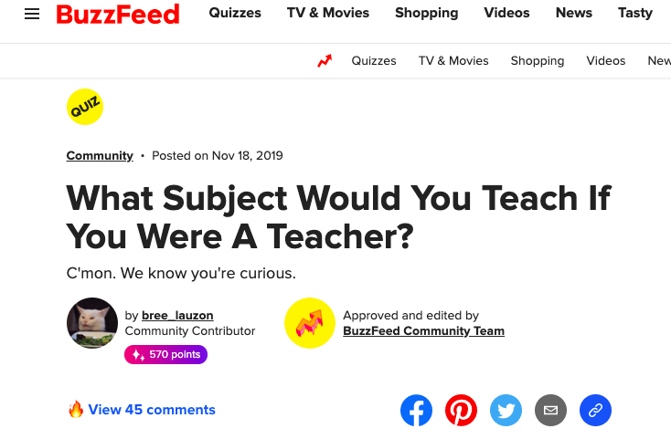
Ivy Ivy & Chessa Birrell take on Buzzfeed
https://github.com/ksu-is/Buzzfeed-Quiz

