Slide 1
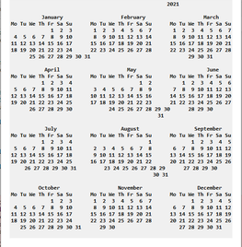
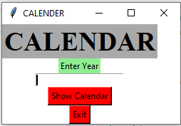
Calendar-GUI
A program that helps with organizing your daily activities.
Coder: Catherine Nyankun and Phillip Marcal
Source: https://thecleverprogrammer.com/2020/04/23/python-gui-app-for-calendar/

