Slide 1

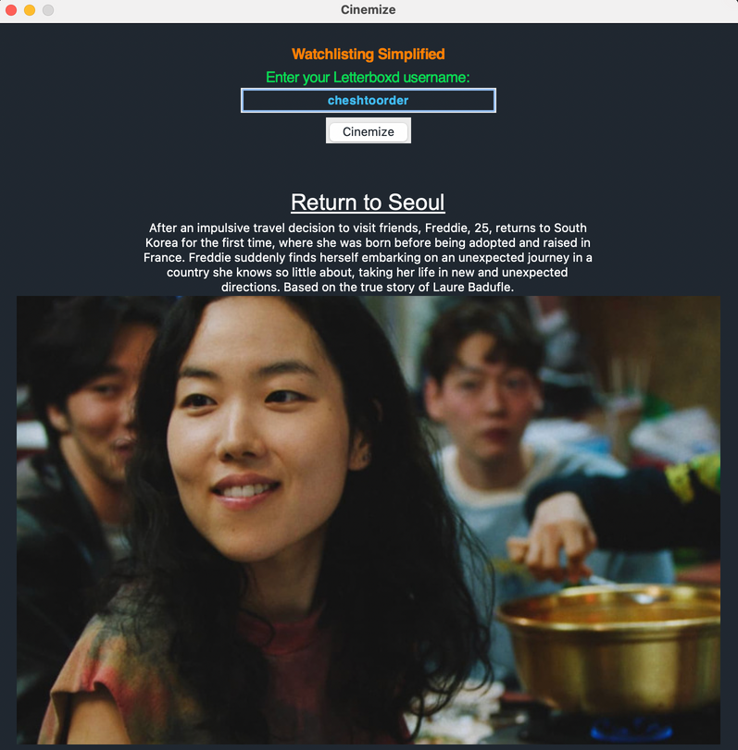



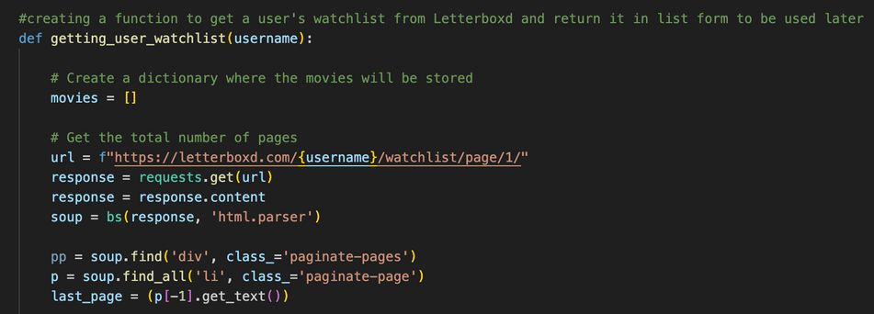
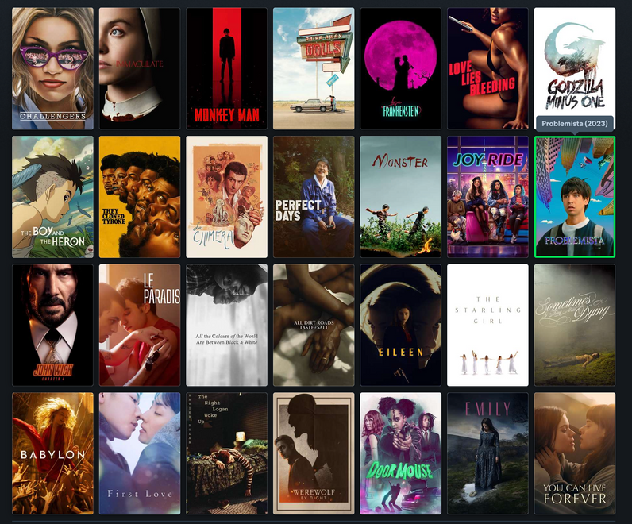






Cinemize
HYPERLINK
TITLE
CAMERON SILVERA-ROBINSON
DESCRIPTION
WATCHLISTING SIMPLIFIED.
Randomly selects and recommends a movie title from a Letterboxd user’s public Watchlist. The recommended movie title is accompanied by a description and an image from the movie.
IMAGE FROM MOVIE
https://github.com/ksu-is/Cinemize---Letterboxd-Watch-List-Randomizer

