Slide 1
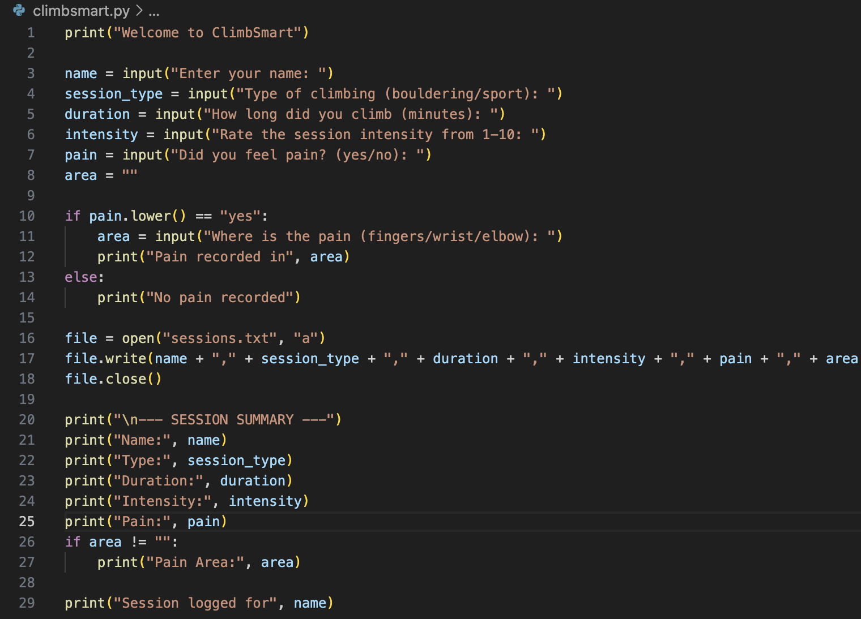
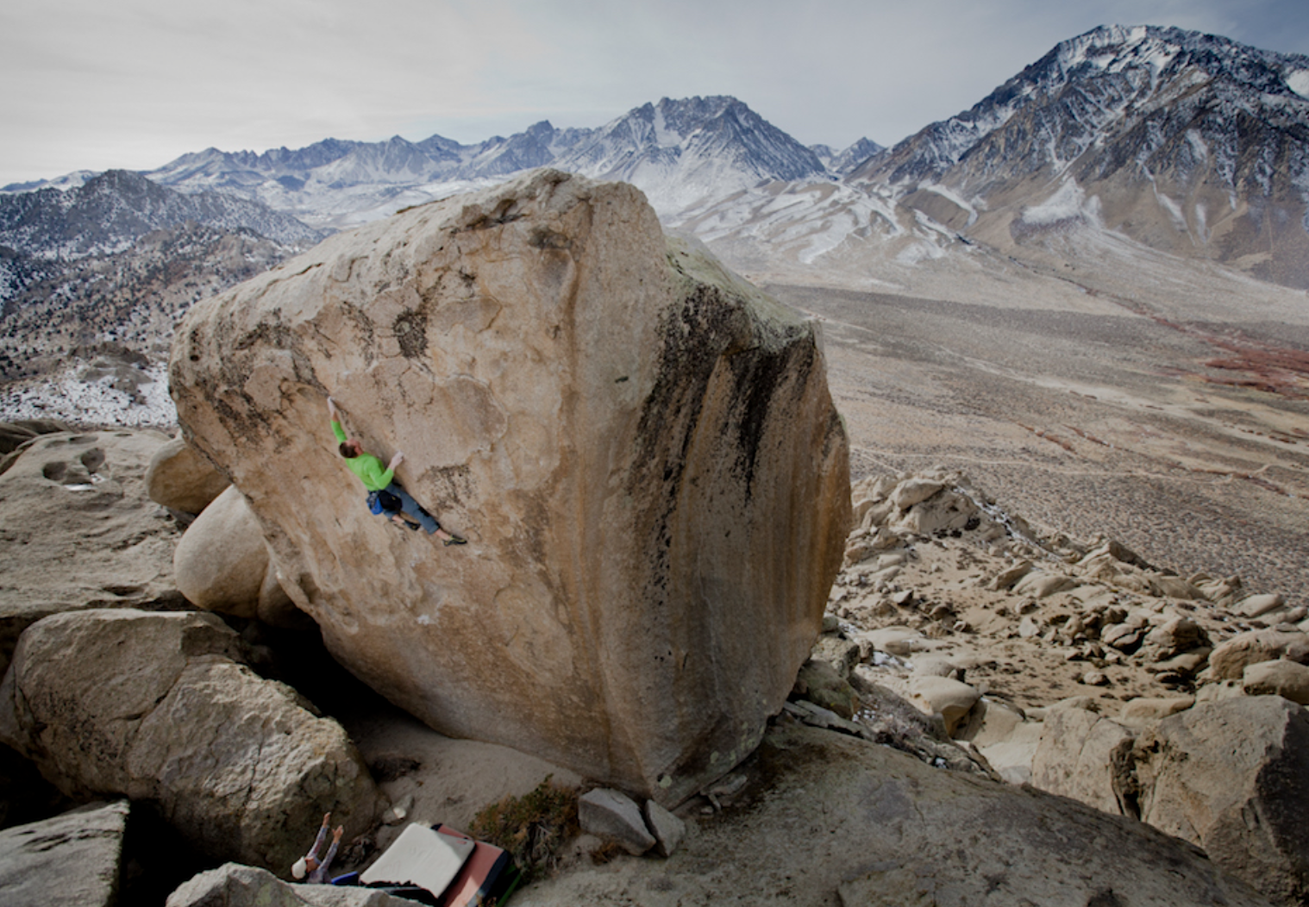
ClimbSmart
By: Jack Gillenwater
“Track your climbing performance and prevent injuries through smart data.”
What ClimbSmart Does:
• Tracks climbing type, duration, intensity, pain, and notes
• Saves session data so users can review training patterns
• Warns users when pain is reported so they can avoid overtraining
Current Code For ClimbSmart

