Slide 1



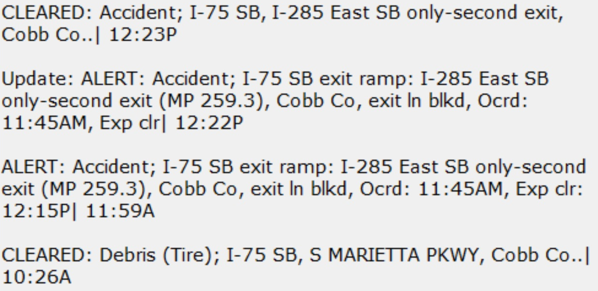

Twitter Commute App, by Owen S.
Before you walk out the door, check GDOT incident reports at a glance!
The app will have a GUI (Tkinter) with buttons for major ATL highways.
User will click on a highway to see the most recent GDOT updates for that highway.
Tweepy will access the Twitter API to pull the last 5 tweets from the highway’s GDOT twitter page
The 5 tweets will be displayed on the screen immediately.
Much faster than searching and checking each page on the twitter app or twitter.com!

